Slide 1




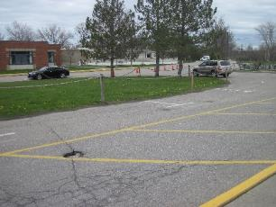
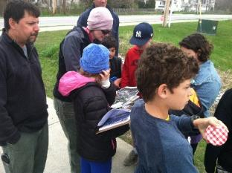
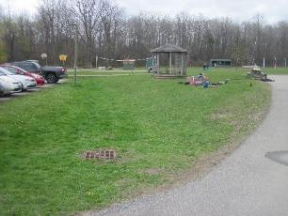
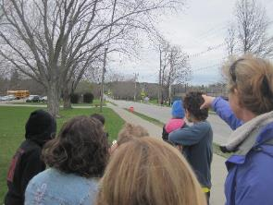
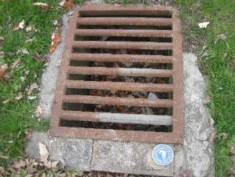
Ahead of the Storm
Education and Outreach
Site Design Process
Presented By: Jessica Louisos, MS, PE
Funded by the Lake Champlain Basin Program - L-2019-032 EO AOTS Project

Slide 2


Review Site Assessment –
Finish site assessment
  Flow path lines
  Erosion areas
  Existing stormwater infrastructure
  Notes on impervious and landuse
  Think about constraints
Identified problem areas
Identified potential treatment areas
Notes:
Students share results – show maps
Look at delineation between Subsheds

Slide 3
Alternatives Analysis
Treatment Goals
Site Constraints
Permit Constraints
Design Lifespan
Constructability
Construction Cost
Maintenance Cost
Notes:
These are all things we need to consider when choosing a design.
Is there anything missing from this list?
Aesthetics? – what does it look like
Habitat? – will birds be attracted

Slide 4
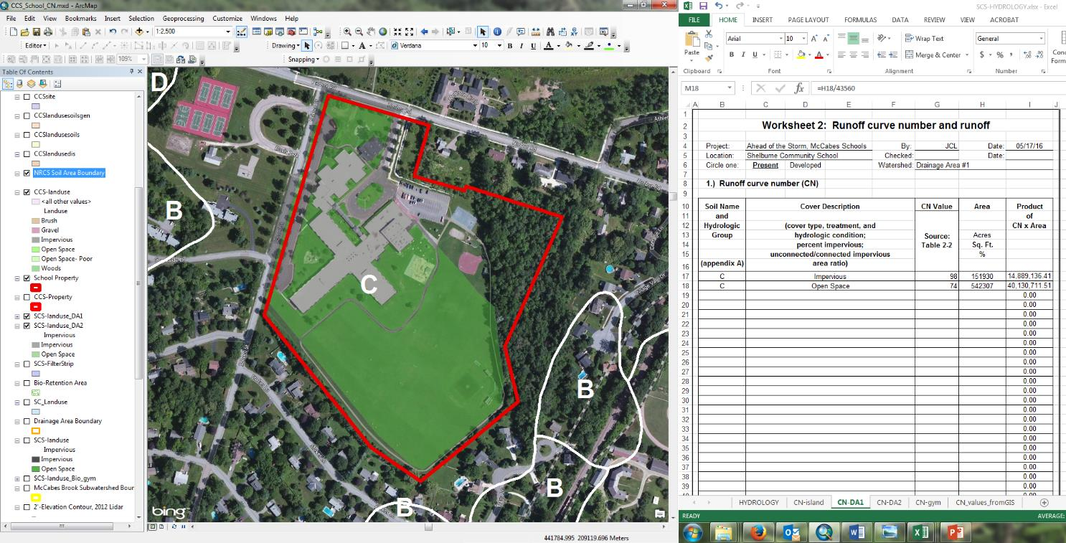
Alternatives Analysis - Calculate Runoff Volume
Notes:
We need to know how much water is going to get to our potential treatment areas so that we can judge what types will work and if there is enough space for them
First we define the watershed area.

Slide 5
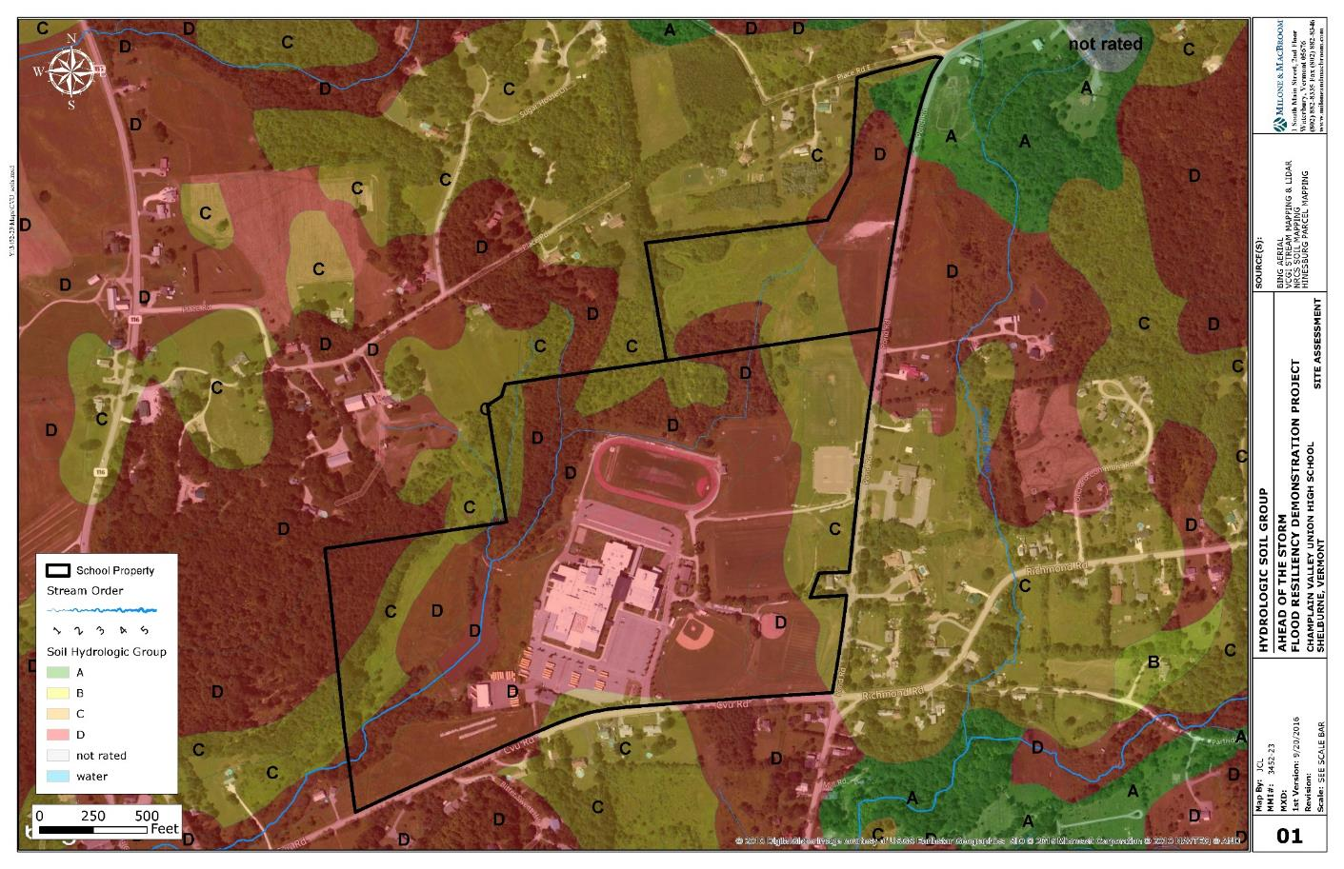
Hydrology - Soils
Notes:
We need to know what type of soils there are.
Soils have different natural infiltration rates that affect how much runoff there is
These are combined with the landuse – grass, woods, impervious

Slide 6
Alternatives Analysis- Calculate Runoff Volume
Notes:
As an example, during the site assessment you identified an area that could be a potential treatment area
You determine how much area drains to the site, maybe you did this during the site assessment.

Slide 7
Alternatives Analysis- Calculate Runoff Volume
WQvolume = P * Rv * A / 12
Where
P = precipitation = 1 inch across Vermont = 1
Rv = runoff coefficient = (0.05 + 0.009 * I) = (0.05+0.009*62.5) = 0.6125
I = percent impervious = 62.5%
A = site area (acres) = 0.8 acres
WQvolume = ( 1 * 0.6125 * 0.8 ) / 12 = 0.0408 acre-feet
= 1,779 cubic feet
Like a 25-foot square room with 3 feet of water
Notes:
Water Quality volume is the amount of water that would runoff the project area during the 1 inch rainfall amount.
This is a standard treatment volume in the State stormwater manual and is calculated based on drainage area, impervious area, and constants
It calculates how big our treatment area needs to be to treat the water draining to the site.
We need this for design
Here is an example from the Shelburne Community School raingarden in front of the school

Slide 8
Alternatives Analysis- Calculate Runoff Volume
12,882 cubic feet is like:
2 feet of water over the basketball court to east of school
Notes:
You may have multiple potential treatment areas with different treatment volumes.
Many stormwater treatment areas area built to handle more water than the WQv, which is a minimum.
There are also standards for the amount of water you need to infiltrate based on soil type, to recharge groundwater
and larger storms where you need to hold the water for a certain amount of time to not increase the peak runoff volume or flow rate

Slide 9
Alternatives Analysis- Consider OCP Options
Soils
Infiltration Capacity
Appropriate location
Available space
Where is water collected
How much water collected
Constraints – utilities?
Maintenance needs
Type of pollutants present
Problem areas – Erosion?

Slide 10
Ahead of the Storm - Optimal Conservation Practices
The 3 S’s….
SLOW IT DOWN
SPREAD IT OUT
SOAK IT IN
Notes:
HANDOUT – Design Principles for Optimal Conservation Practices – use the one from AOTS Information Packet

Slide 11
Ahead of the Storm - Selecting Practices
Stormwater Practice Definitions
Best Management Practices (BMP)
Green Stormwater Infrastructure (GSI)
Low Impact Design (LID)
Optimal Conservation Practices (OCP)
Notes:
BMPs reduce the quantity and improve the quality of stormwater – they can be an action or a structural improvement (something you build)
GSI are BMPs that promote natural ecological function on site specifically to restore and maintain natural hydrologic processes, many include plants which evapotranspirate
LID are land planning and site design practices that limit the amount of impervious surface and minimizes environmental degredation when designing a development
OCP takes these a step farther to where possible treat stormwater from larger weather events and protecting ecosystem functions – the approach may include designing something above the minimum requirements for permit compliance
Some practices can fall within all of these categories – like a raingarden

Slide 12
Rainbarrel / Cistern
Vermont LID Manual, VTDEC, 2010
Notes:
Rainwater harvesting = storage and reuse
Can use water for irrigation, gardening
I use my home rainbarrel for watering my indoor plants too.

Slide 13
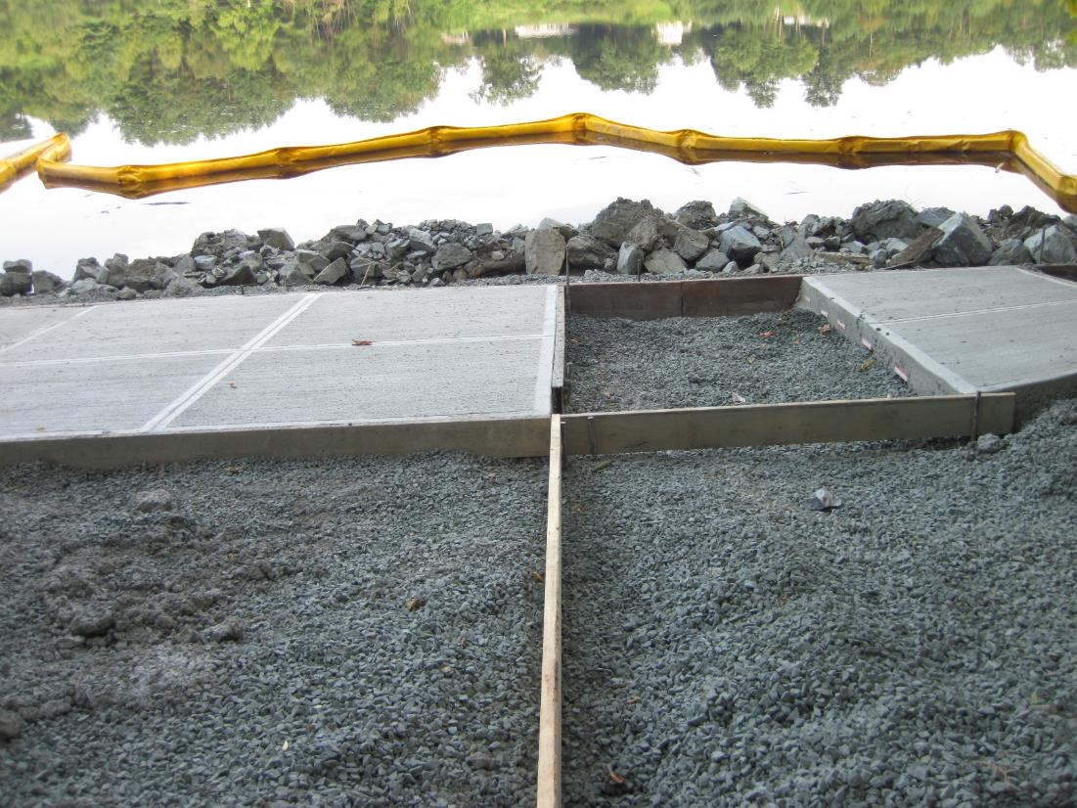

Pervious Pavement or Concrete
Dartmouth College, Connecticut River Edge, Hanover, NH, Summer 2013
Notes:
Infiltration - This could also be pavers (like bricks)
It is a hard surface that has pores so that water can run though it and into the ground below.
Ice, salt, and sand can be issues with this type of treatment because it can get clogged and is flat, so rain has to get into it quickly or runs off

Slide 14
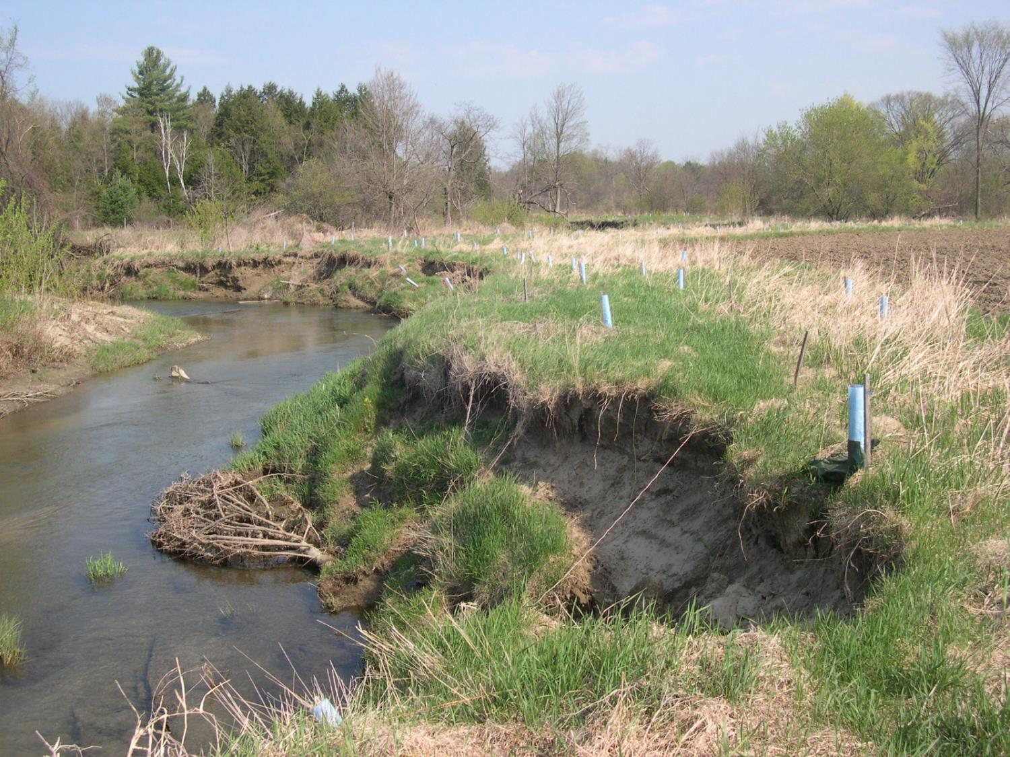
Riparian Buffer Planting / Reforestation
Lewis Creek
Starksboro, Vermont
Terry Dinnan, 2005
Notes:
Trees act as natural reservoirs – intercept and store rainfall
Reduces stormwater runoff
Need to be planted in uncompacted soils

Slide 15
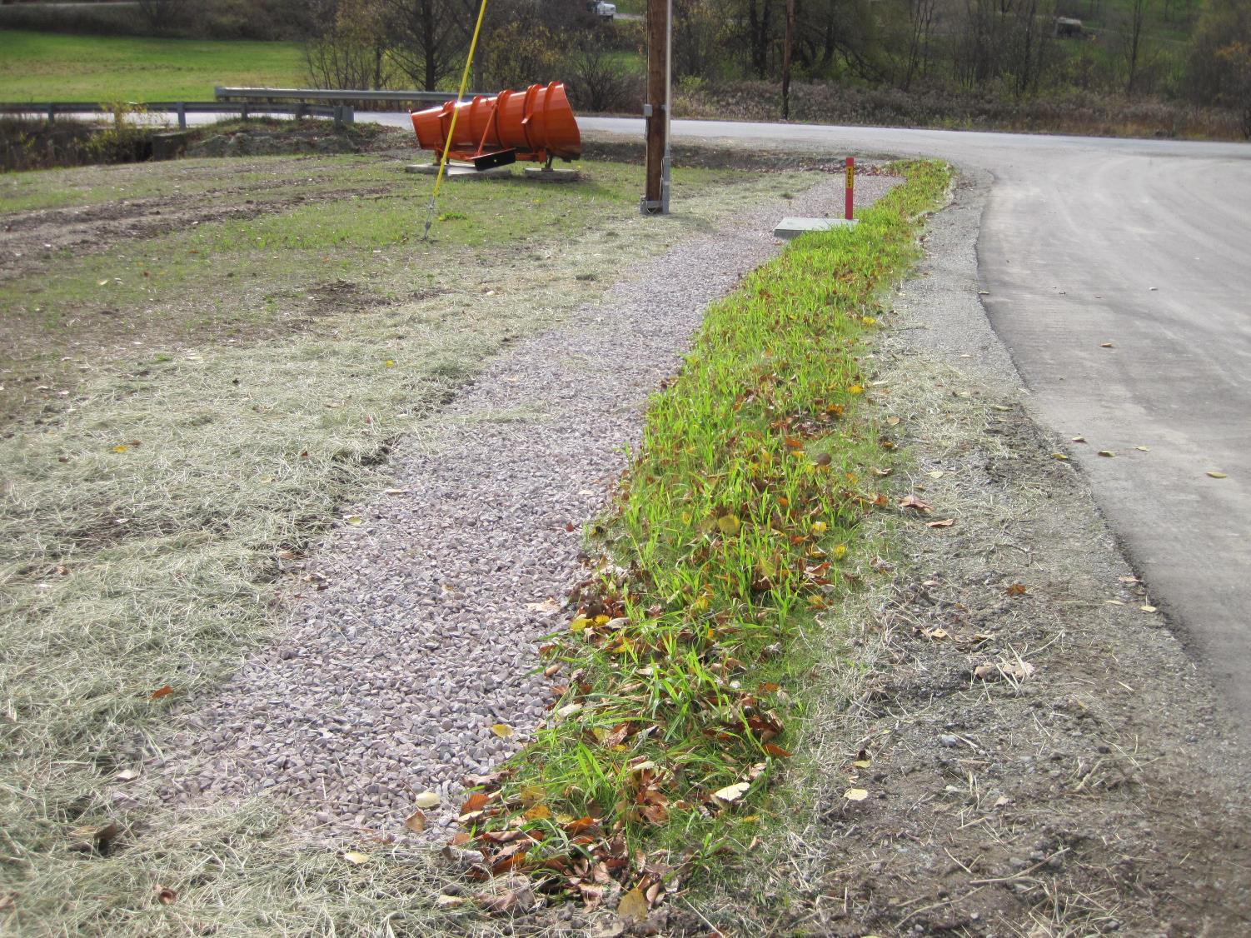
Disconnection to Vegetated Buffer or Filter Strip
Hinesburg Town Garage
November 2018
Notes:
Water flows off of an impervious surface and spreads out over a vegetated area
Sometimes a gravel strip is included to slow down water and do some filtering
Important that the water is spread out

Slide 16
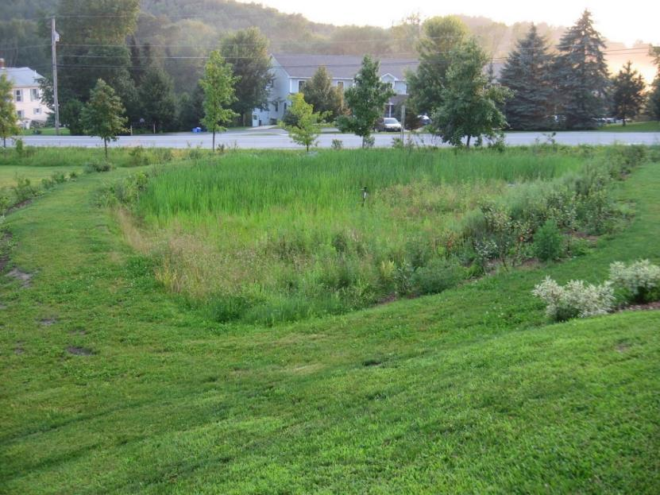
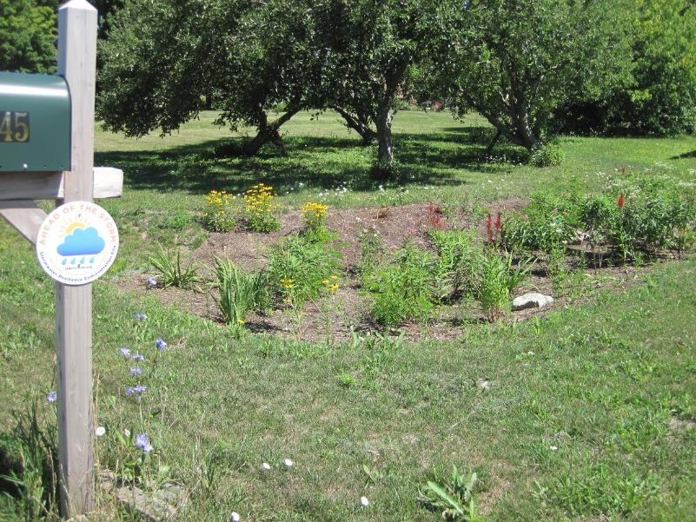
Raingarden / Bio-Retention
A Family’s Home, Charlotte, Summer 2018
Town Property, Silver Street, Hinesburg, Summer 2014
Notes:
Shallow, vegetated basins that collect and absorb runoff
Includes evapotranspiration – water released to the air when plants breath
If possible infiltration,
but if soils are poor – can have underdrain that collects water after it filters through the soils

Slide 17
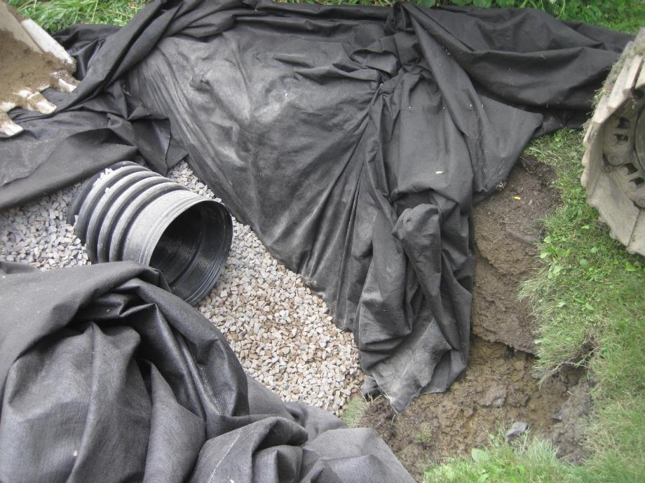
Infiltration Trench
Brook Lane, Shelburne, Vermont, Summer 2016
Notes:
Allows water to seep through the stone and out into the ground
Stone provides filtering
If there is a pipe, it would have holes in it to allow the water to get into the ground

Slide 18
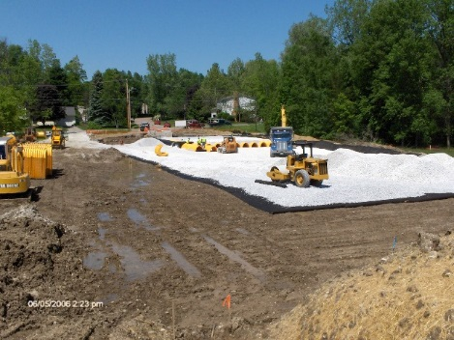
Infiltration Galleries
Hullcrest Road, Shelburne, Vermont, Summer 2012, photo by: Bernie Gagnon

Slide 19
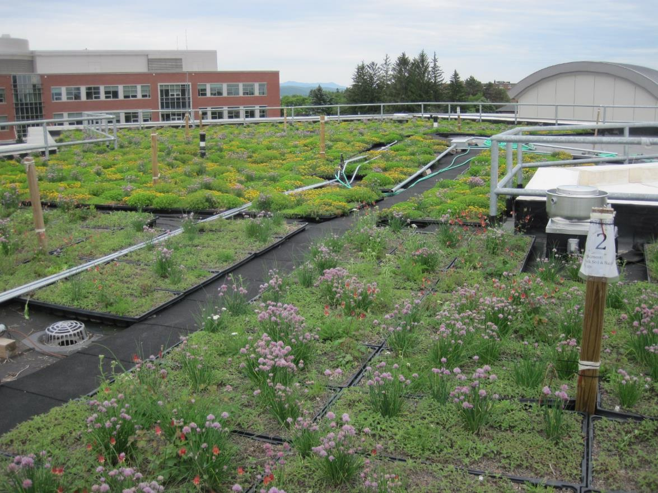
Green Roofs
UVM Aiken Building, photo taken June 2013
Notes:
A roof of a building covered with special soil and plants
Stores and treats water on the roof, where it lands.
Absorbs, Stores, Evapotranspire
Most cost-effective where there isn’t much land available – like in cities
Not all roofs are strong enough to hold the extra weight

Slide 20
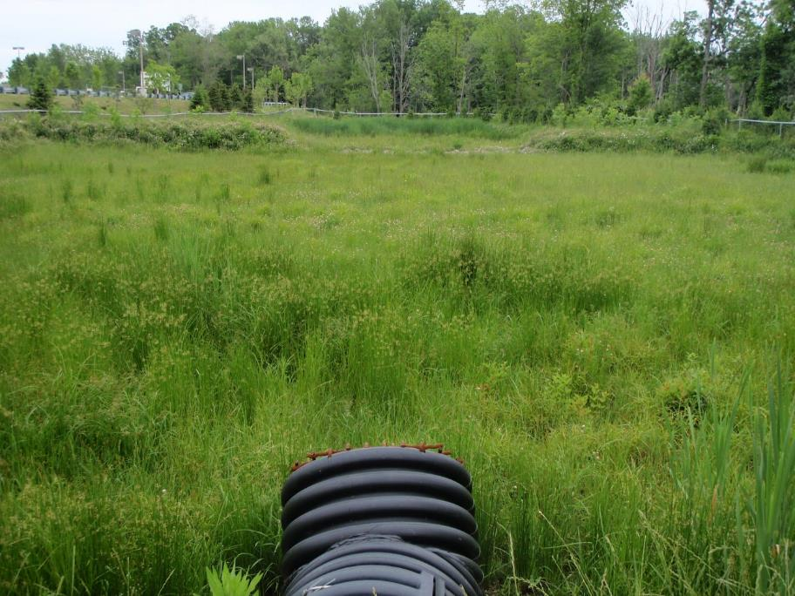
Constructed Wetland
UNH Stormwater Center, 2009
Notes:
Shallow depression designed to mimic natural wetlands
Lots of plants
Water moves through wetland underground and is filtered

Slide 21
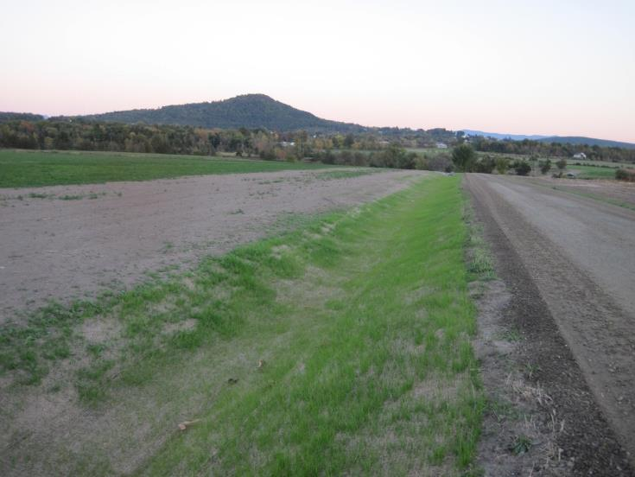
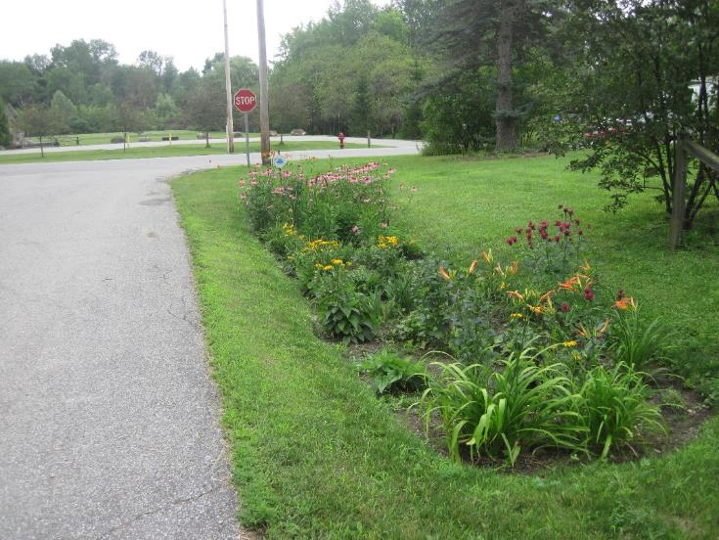
Vegetated Swales
Reconstructed grass swale, East Thompson’s Point Road, Charlotte, Vermont, Summer 2016
Swale with Raingarden, Woodbine Road, Shelburne, 2017
Notes:
Provide treatment and retention as they move water
Slow, infiltrate, and filter better than narrow unvevegetated swales
Wide bottom, shallow slopes, vegetated
If steep, need rock to slow the water down and prevent erosion

Slide 22
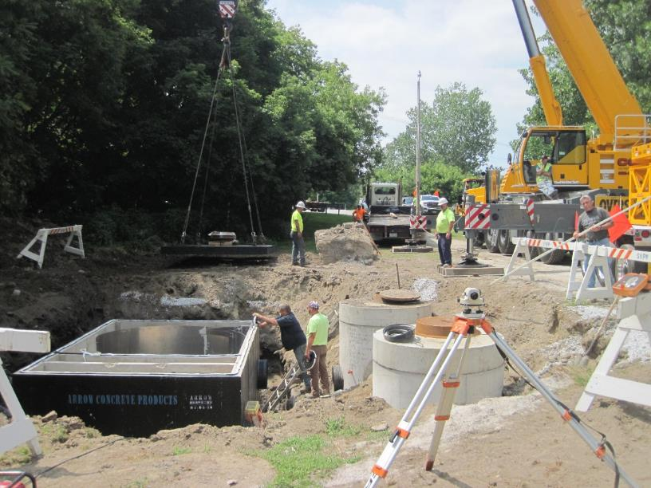
Hydrodynamic Separator
Contech Vortechs Unit being installed in Swanton, VT Summer 2016
Contech Stormwater Solutions, CDS Unit
Notes:
Sometimes when the water is already collected in a pipe system, a more structural approach is needed
A separator swirls the dirty water around and allows the sediment to settle out into the bottom and it can be removed
A normal catch basin does not collect much of the sediment and it then travels down the pipes

Slide 23
Design Resources
The Vermont Rain Garden Manual “Gardening to Absorb the Storm”
http://www.uvm.edu/seagrant/sites/default/files/uploads/publication/VTRainGardenManual_Full.pdf
Vermont Low Impact Development Guide for Residential and Small Sites
https://anrweb.vt.gov/PubDocs/DEC/WSMD/stormwater/docs/sw_LID%20Guide.pdf
Vermont Green Stormwater Infrastructure (GSI) Simplified Sizing Tool for Small Projects
http://www.vpic.info/GreenInfrastructureCalculatorsAndSizingTools.html
Vermont DEC Stormwater Program
http://dec.vermont.gov/watershed/stormwater
University of New Hampshire Stormwater Center
http://www.unh.edu/unhsc/

Slide 24
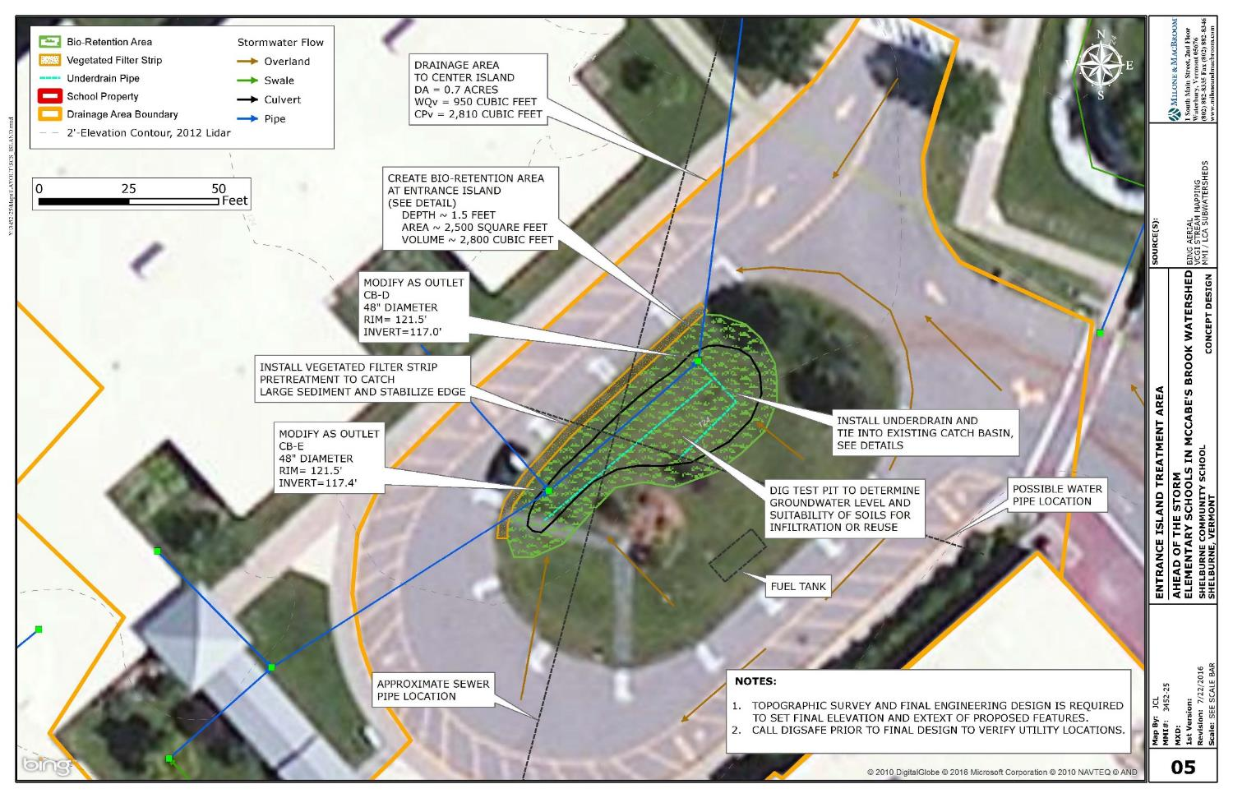
Layout Example
Notes:
Here are some examples of what a concept design might look like
Notes on an aerial photo
Areas circled where treatment can go
Arrows for where water flows
Constraints – utilities, benches, flagpoles- other things that can’t be moved

Slide 25
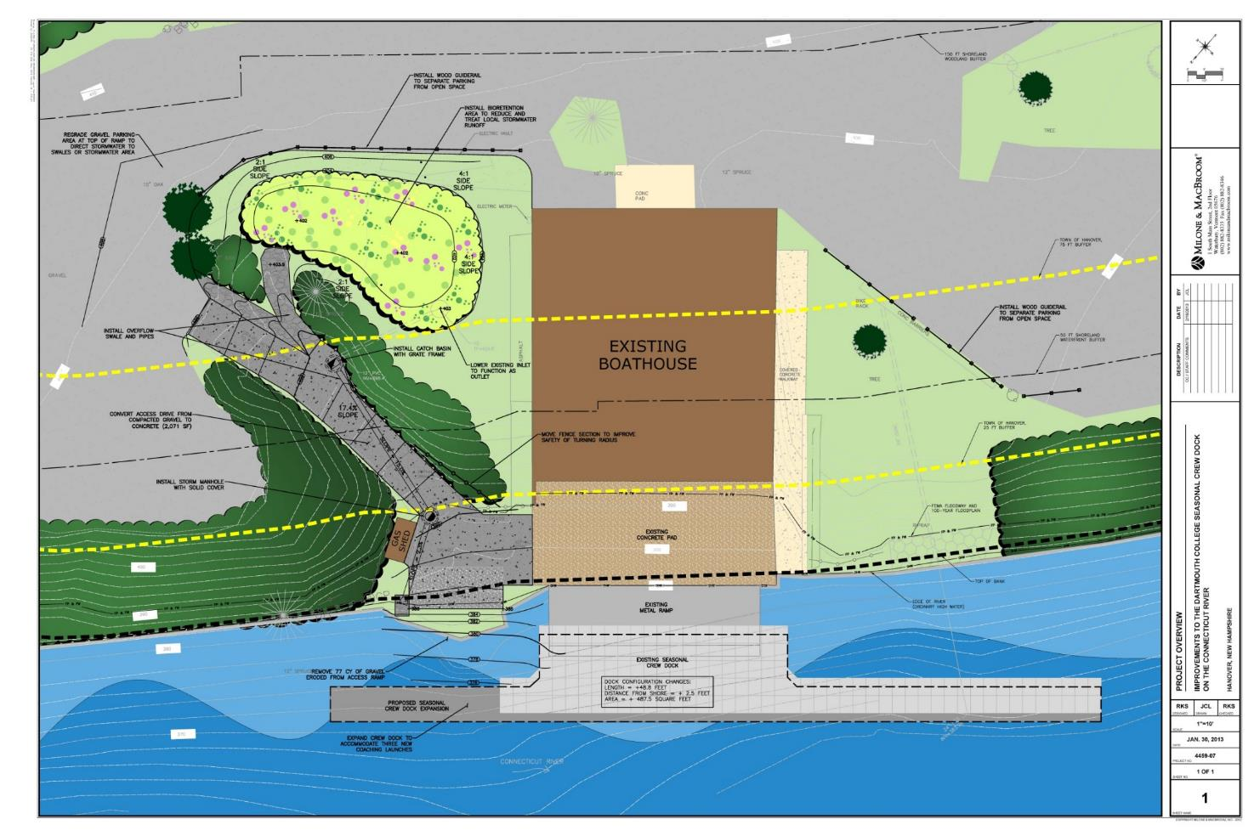
Site Layout
Notes:
Sometimes site features can be colored in so you can clearly see where things are going to go and what they might look like

Slide 26
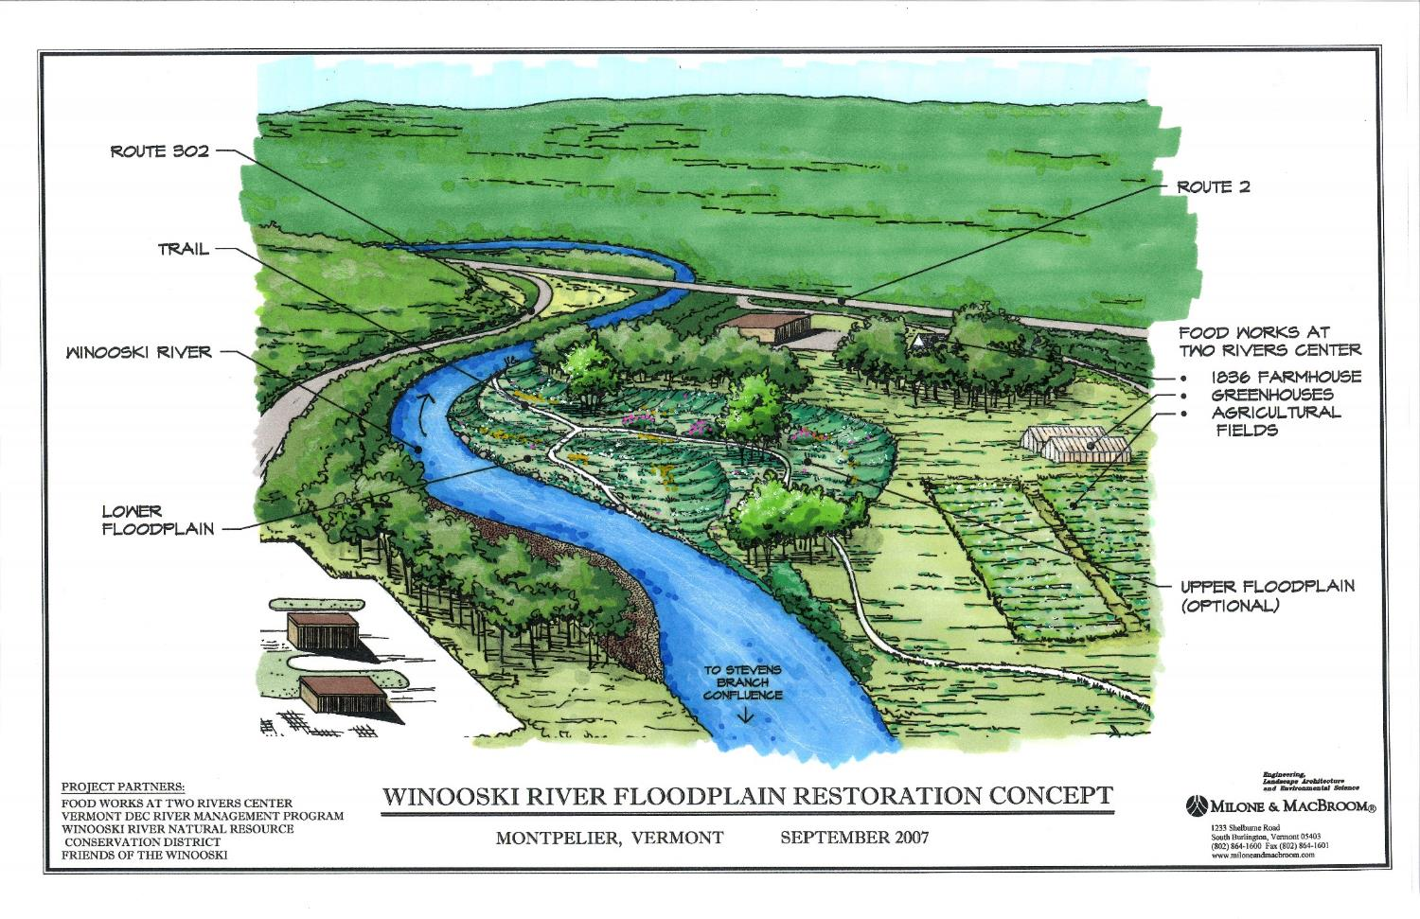
Site Layout
Notes:
Similarly, this is a perspective rendering
Landscape architects often use this type of drawing to show what a design will look like

Slide 27
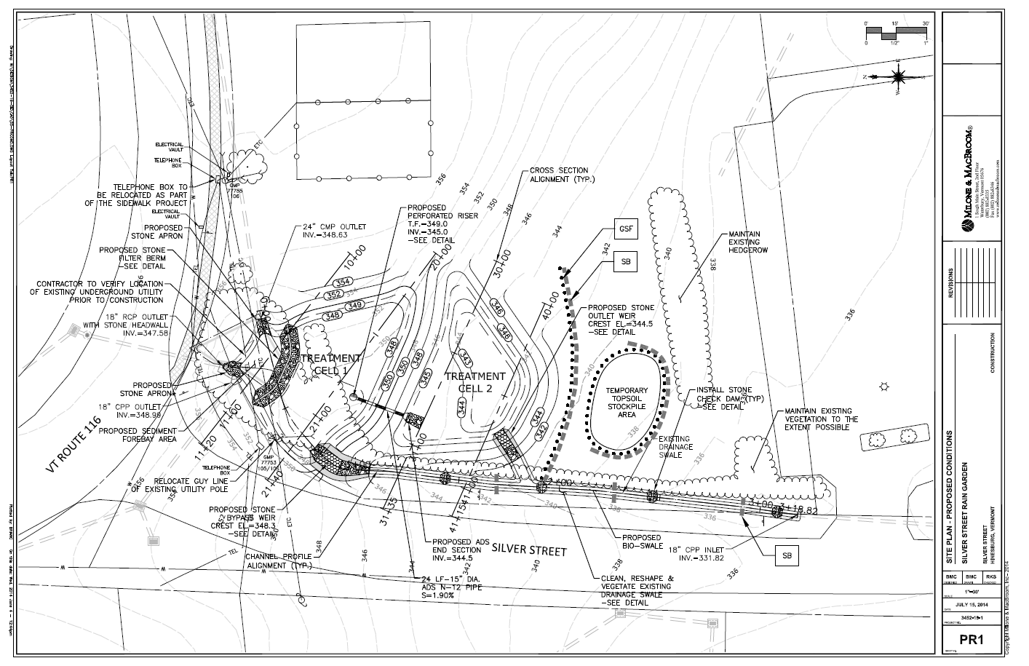
Site Layout
Notes:
Sometimes designs have survey, (blueprints)
Less colorful, but a contractor can follow these for construction
Usually needed for more advanced designs

Slide 28
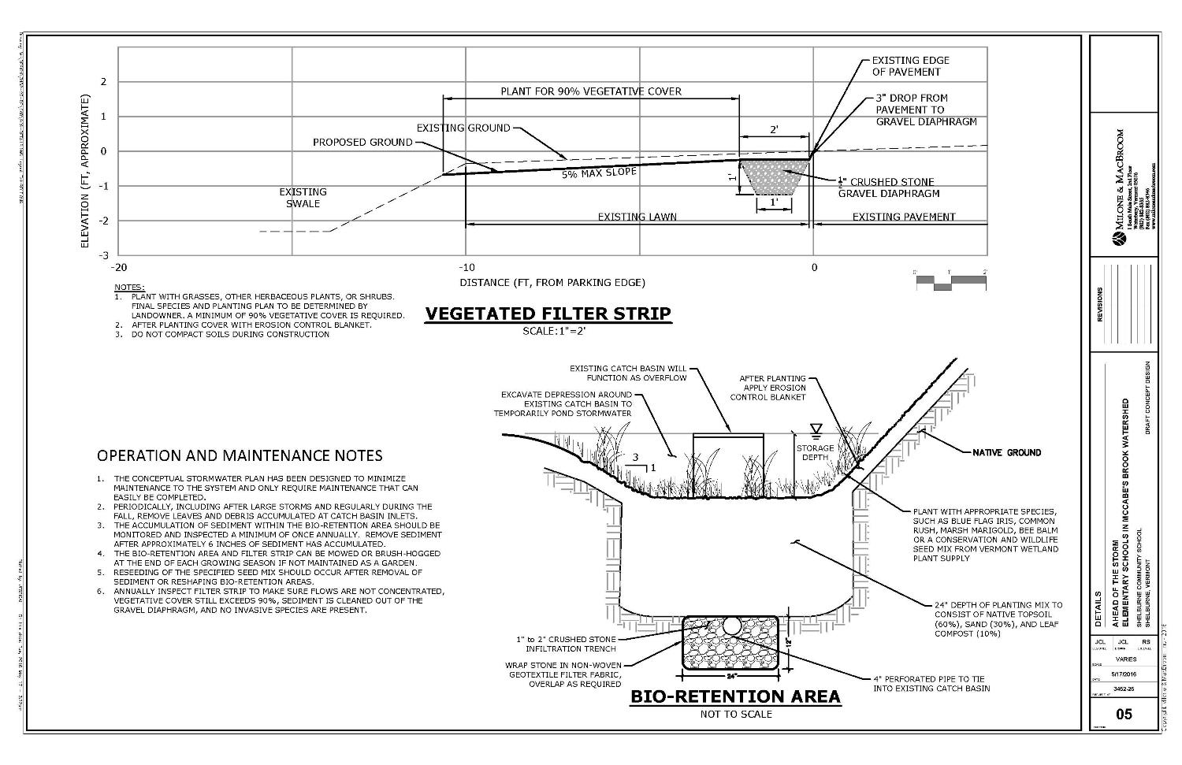
Design Plans - Details
Notes:
Engineering details give specific information on how things need to be built
Slopes, depths, angles, size of stone, the type of erosion fabric
Maintenance notes are sometimes included here

Slide 29
Do this at Home!
The Ahead of the Storm process can be done on any type of property – and has – schools, churches, homes, public buildings, town garage, town forest…
The design process is transferable
Start at the beginning with a site assessment
Notes:
Many of the treatment options are easily implemented and don’t need the expertise of an engineer.
Install a rain barrel, spread out water from a downspout or concentrated on a driveway.
Discuss what steps might need to be done by an engineer – have students look at the handout and identify things they could do or might need help with.

Slide 30
Design – Field Activity
Look at problem areas
Identify possible locations for additional stormwater treatment
Think about solution types
Discuss site constraints
Review Site Assessment Goals in Field
Answer questions

Slide 31
Homework –
Finish site assessment (Review Design Process handout)
  Locate problem areas
  Locate areas of existing treatment
  Locate possible locations for treatment
Start Design
  Think about solution types
  Note site constraints
  Choose recommended actions and sketch on site plan
Review Optimal Conservation Practices Design Principals Handout
Notes:
This is likely only for more advanced students.

Slide 32
More advanced concepts
Maybe these are for older students or teachers only?

Slide 33
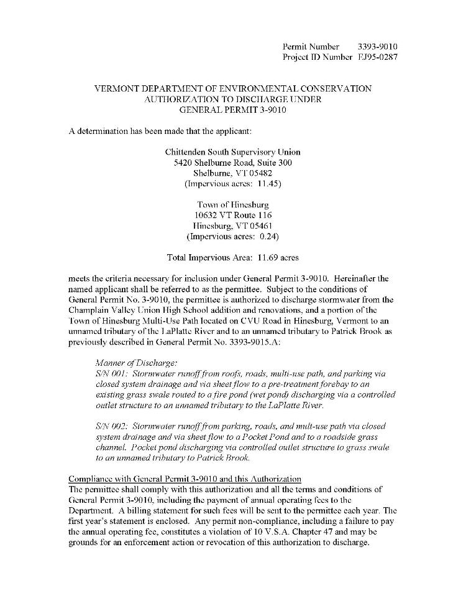
Stormwater Regulations
Stormwater Permit with State DEC
Does Treatment meets regulatory standards?
New Permit Requirements for sites with more than 3 acres of impervious.
Notes:
Many existing properties do not fall under even these new more advanced regulations and runoff from that existing impervious surface is not treated.

Slide 34
Permit Drainage Area Mapping – Example - CVU

Slide 35
Subwatershed Delineation
Notes:
In the field exercise we delineated a watershed/ drainage area to our practice by walking around and finding the “high spots”
Those high spots were our boundaries.
This can also be completed using contours on a map
where rivers and ridges make V shapes
Draw boundaries perpendicular to the contour lines

Slide 36
Advanced Hydrology
Design needs to accommodate safely larger storms than the WQv
Treatment is typically provided for the Channel Protection Volume
  1-year, 24-hour storm
  Match pre-development timing, volume, flow
Overbank Protection Standard
  10-year, 24-hour storm
  Match pre-development peak flow rate
Notes:
Describe general methods for calculating velocity, CPv, and flows for rain events 2, 10, 50, 100 yr
Would have to treat the 100-year storm to not increase peak flows if developing more than 10 acres.
Detailed drainage areas
Landuse/ soils analysis – done in GIS
Hydrology modeling – combining landuse, soils, flow path length, and uses modeling software

Slide 37
Advanced Hydrology
Design should match the goals of the project
Increase resiliency
Make sure even highest storm events can pass without causing damage
Check velocities for 100-year storm, even if it just overflows and is not treated
Notes:
What size rain event is treatment practice designed for?
If treating for phosphorus removal – filter or infiltrate a volume greater than the WQv
If flooding and erosion downstream – detain a volume larger than the CPv – try for the 10-year
Maximize infiltration, storage, spreading water
Reduce any concentrated flows
Circle back and see if there are ways to reduce creation of impervious surface, or restore pervious.

Slide 38


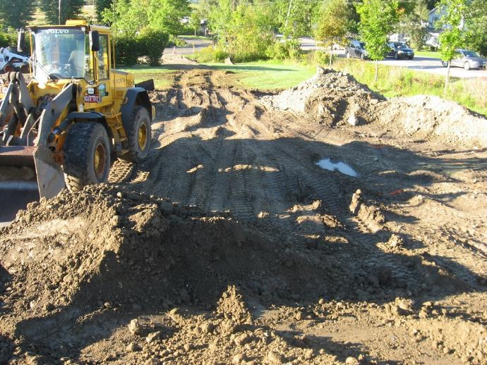
Next Steps
Gather Feedback
Finalize Concept Design
Cost Opinion
Fundraise and Gain Support
Final Design
Permits
Construction Plans
Implement

