Slide 1




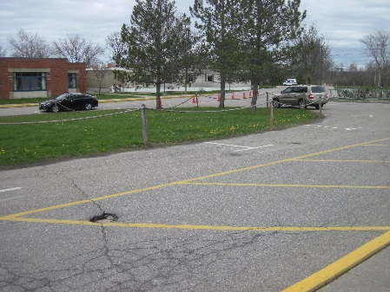
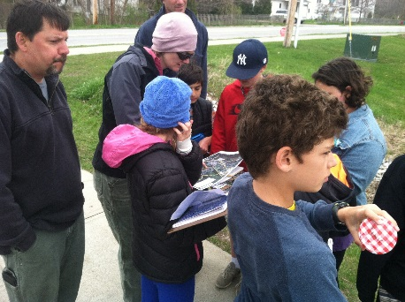
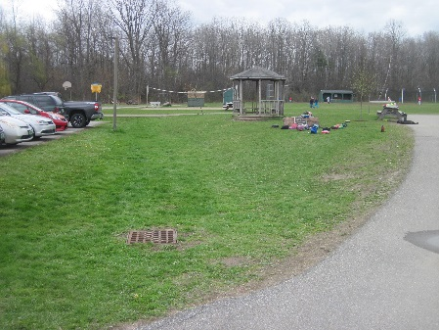
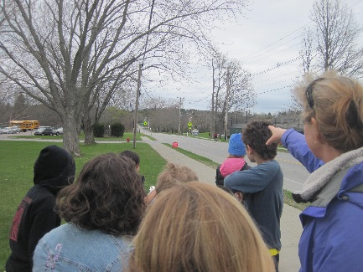
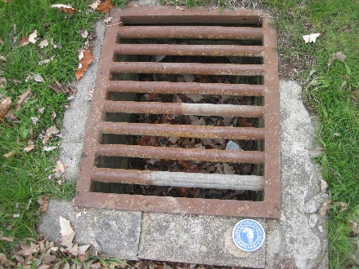
Ahead of the Storm
Education and Outreach
Introduction to Watershed Science, Stormwater, and Resiliency
Presented By: Jessica Louisos, MS, PE
Funded by the Lake Champlain Basin Program - L-2019-032 EO AOTS Project

Slide 2



Overview
Learn about:
  Stormwater Runoff
  Water Quality
  Preparing for Extreme Storms
  Weather versus Climate
  Flood Resiliency
Complete:
  Watershed Activity
Notes:
There will be a second session focused on site assessment and design

Slide 3
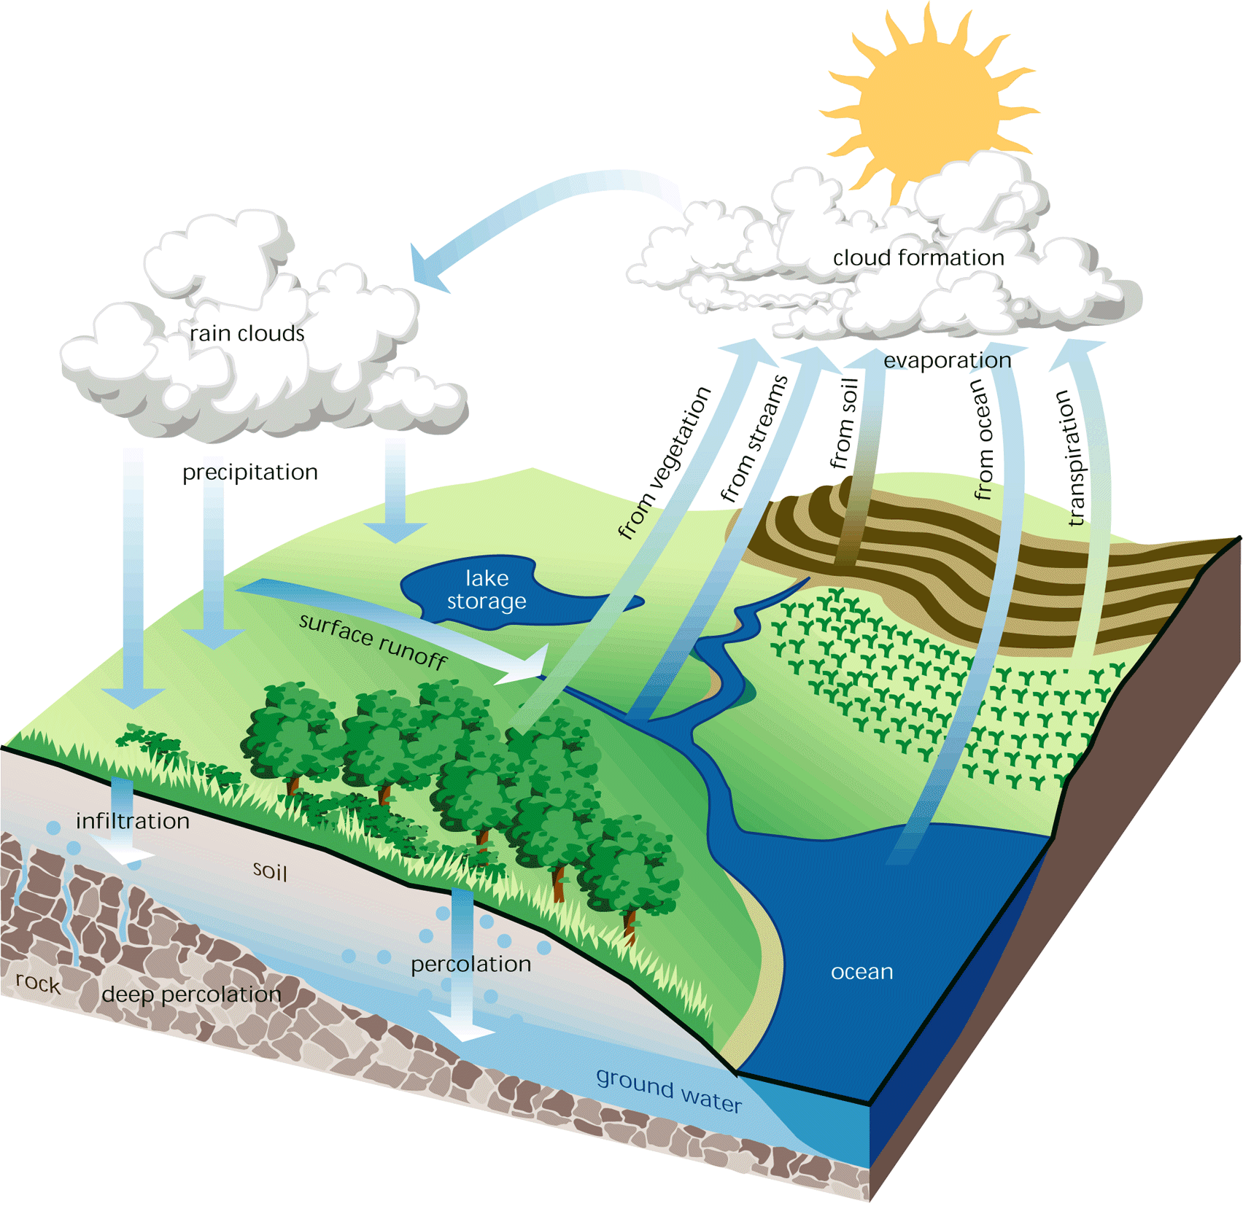
The Watershed
  (FISRWG, 1998)
Notes:
A watershed is an area of land that flows to a common body of water like a stream, river, lake, or ocean.
Who lives in a watershed?

Slide 4
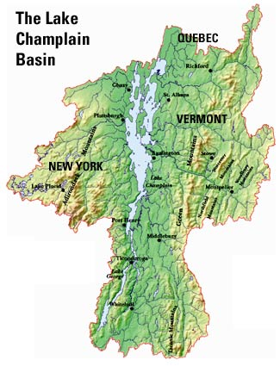
The Lake Champlain Watershed
Notes:
A watershed is an area of land that flows to a common body of water like a stream, river, lake, or ocean.
It can be large like the Lake Champlain Watershed- 8,000 square miles or
Very small like the watershed draining to a very small pond.

Slide 5
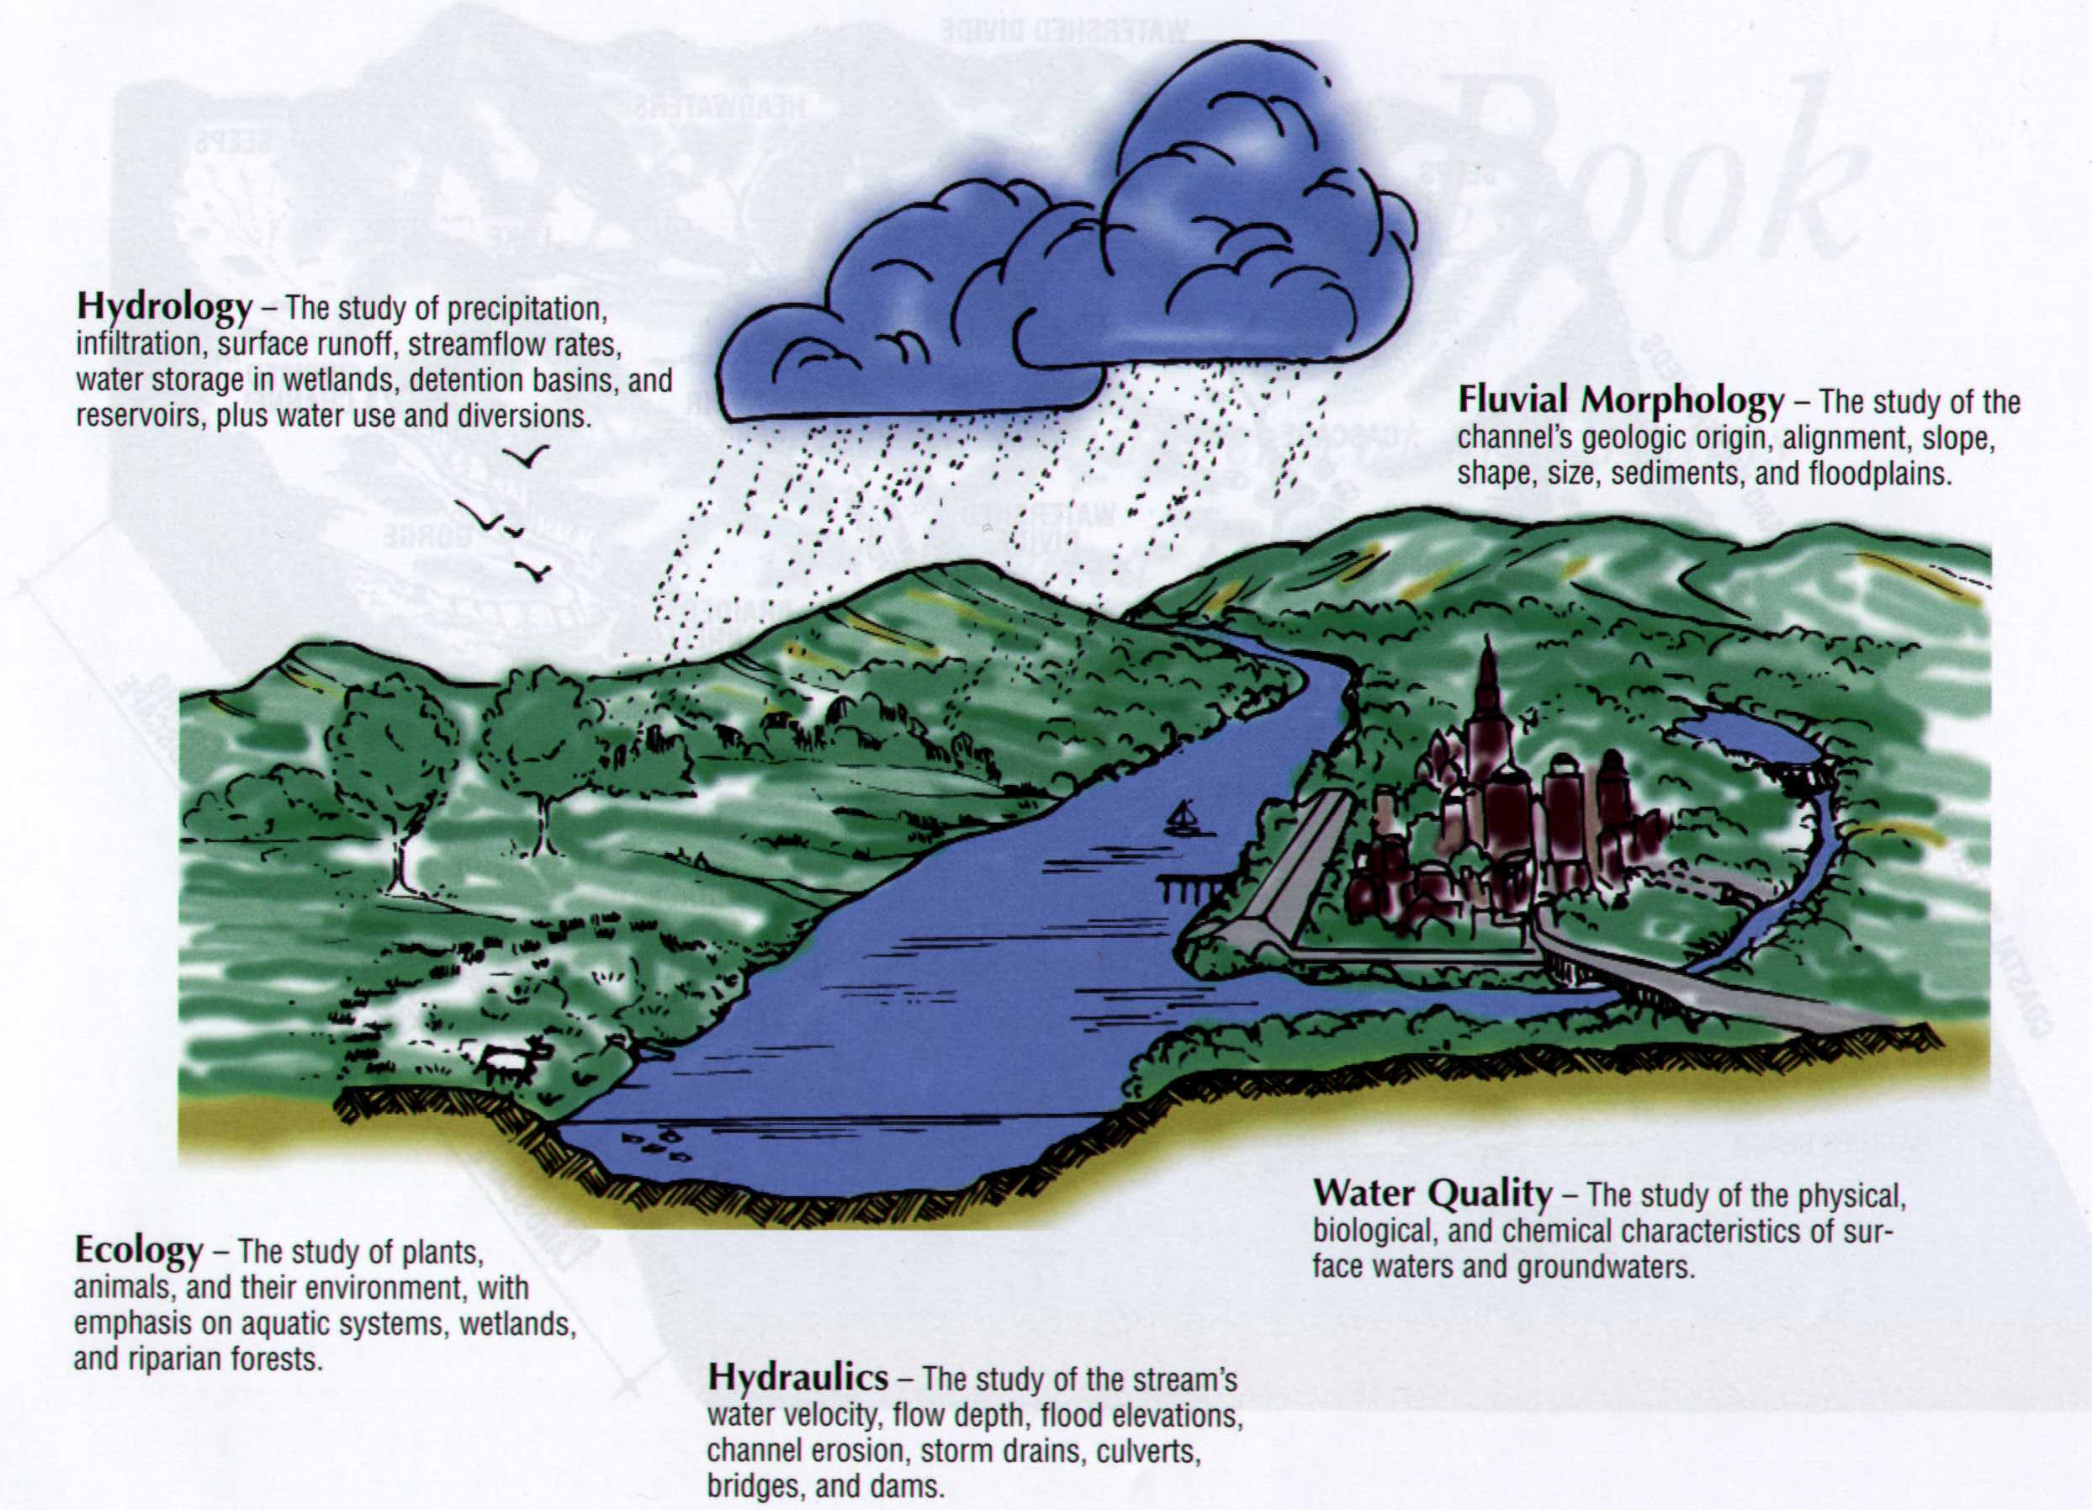
Hydrology - The study of precipitation, infiltration, surface runoff, streamflow rates, water storage in wetlands, detention basins, and reservoirs, plus water use and diversions.
Ecology - The study of plants, animals, and their environment, with emphasis on aquatic systems, wetlands, and riparian forests..
Water Quality - The study of the
physical, biological, and chemical
characteristics of surface waters and groundwaters.
Hydraulics - The study of the stream’s water velocity, flow depth, flood elevations, channel erosion, storm drains, culverts, bridges, and dams.
Engineering/Construction –
The application of science and mathematics in analysis, design, permitting, and construction.
Fluvial Morphology - The study
of the channel’s geologic origin, alignment, slope, shape, size, sediments, and floodplains.
Socioeconomic - The study of the sociology, social relationships, economic impacts, and their interconnections.
  (MacBroom, 1981)
Notes:
What types of people’s jobs might work with watersheds?
Here are a few- many different types of scientists and engineers.

Slide 6
Impervious Surface
What does IMPERVIOUS
mean?
Notes:
Does not allow fluids to pass through
In the case of rain – it hits it and can’t get through, so it runs off and becomes stormwater runoff
What are examples? – pavement, parking lots, streets, buildings, sidewalks, gravel, other compacted areas

Slide 7
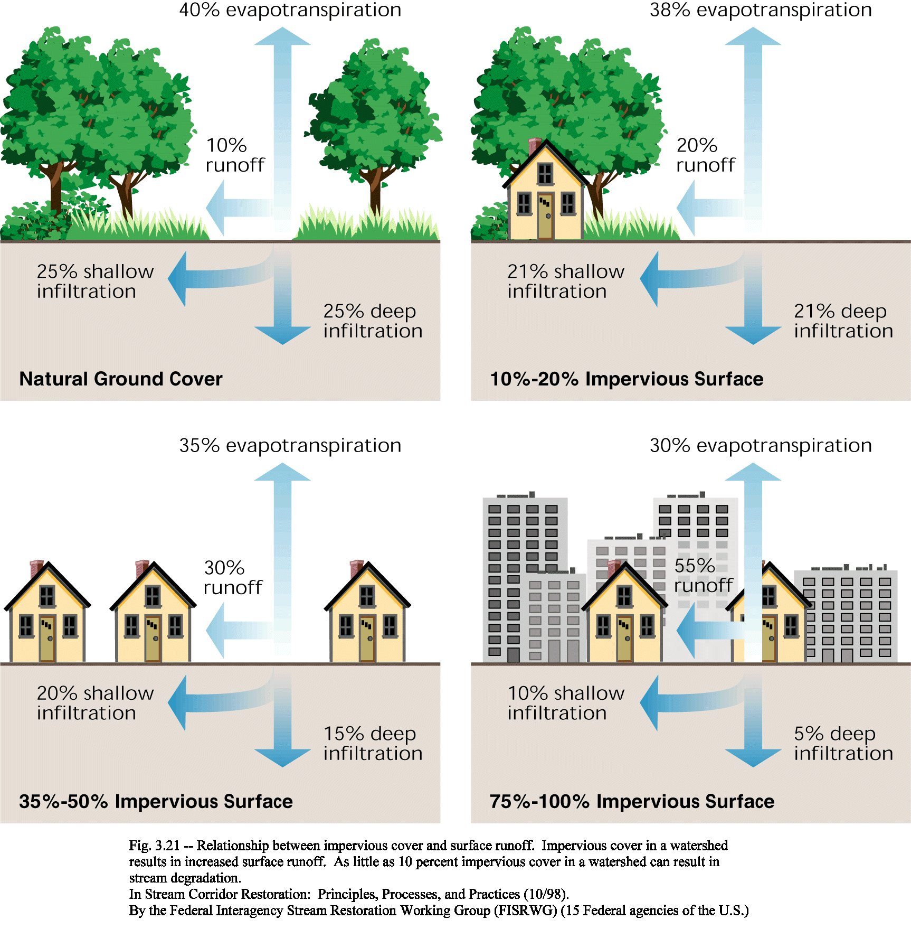
Runoff versus Infiltration
Notes:
Pervious surfaces like plants and healthy soils help water infiltrate (seep) into the soils and reduce runoff.
Runoff from surfaces can pick up pollutants and transport them to downstream waters.
The pollution can impact aquatic ecosystems.

Slide 8
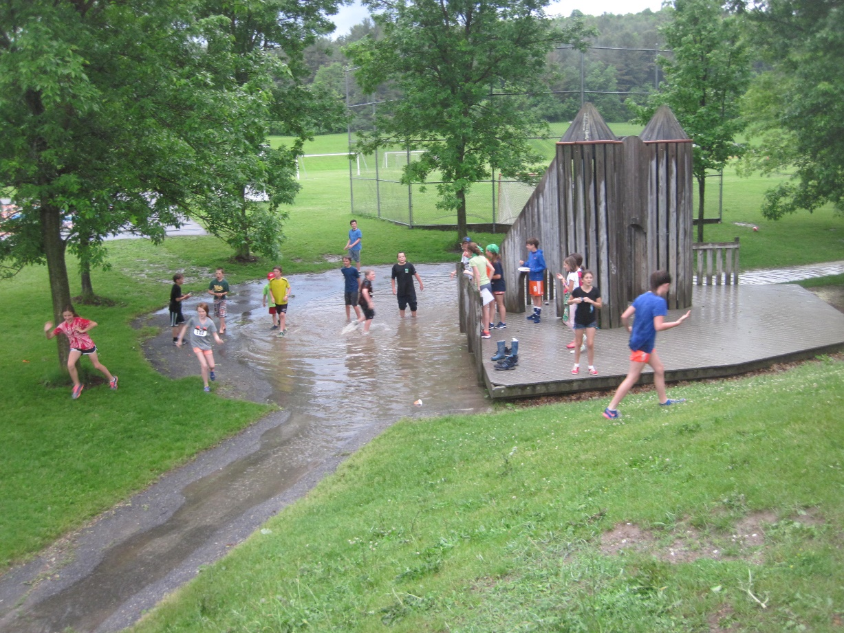
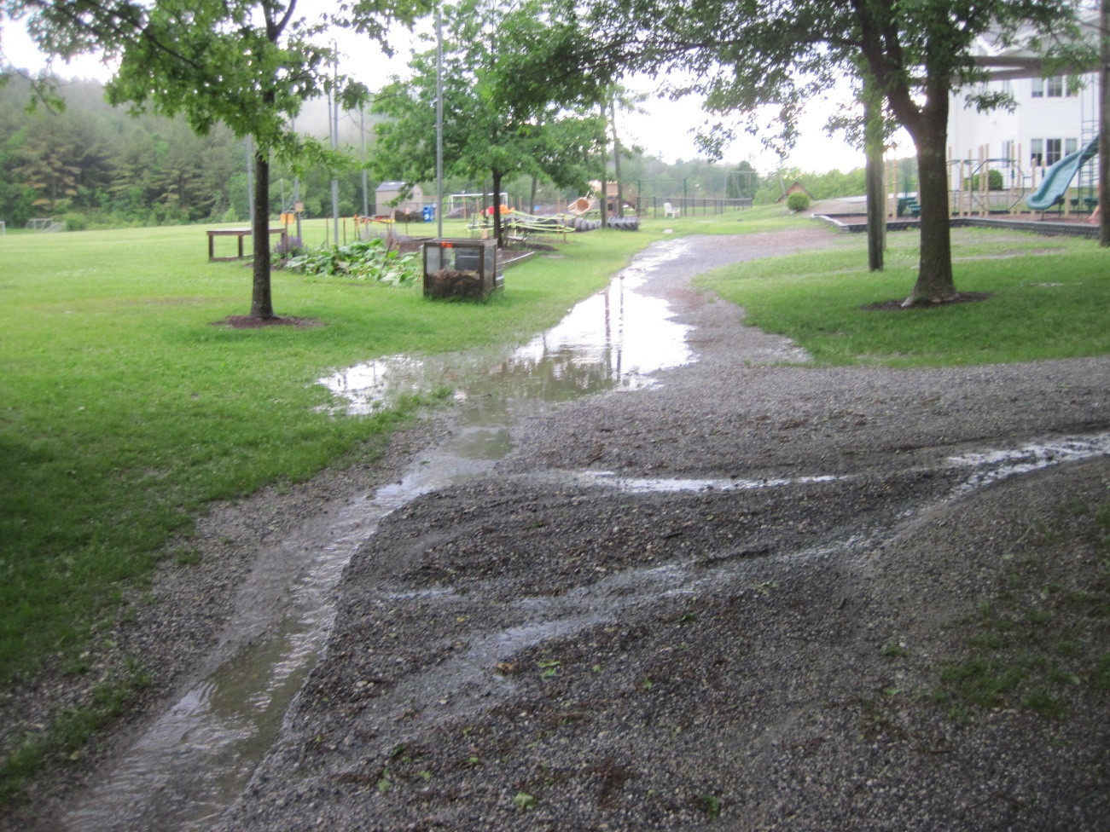
Stormwater Runoff
Why is runoff so bad?
Charlotte Central School
June 7, 2016
j. louisos
Notes:
Stormwater Runoff is rain that hits the ground and can’t infiltrate so it runs along the ground surface.
Why is that so bad?
As it goes it collects dirt or other pollutants on the ground and carry’s them to the next downstream waterbody.
We removed natures resiliency tactics

Slide 9
Brainstorm what Pollutants are in Stormwater
POLLUTANT TYPES:
Litter
Sediment
Bacteria
Nutrients
Pesticides
Heavy Metals
Salt
Lake Champlain
Basin Program
Stormwater Curriculum,
2019
Notes:
Start activity from SeaGrant SW Curriculum Section 1B – “What types of pollutants might be in stormwater?”
For each area identify the types of pollutants that could potentially be found in stormwater runoff from each of these places
10 minutes alone, then 5 minutes to discuss with a partner
Review as a class
By understanding pollutants we can better prevent them from getting to our waterways

Slide 10
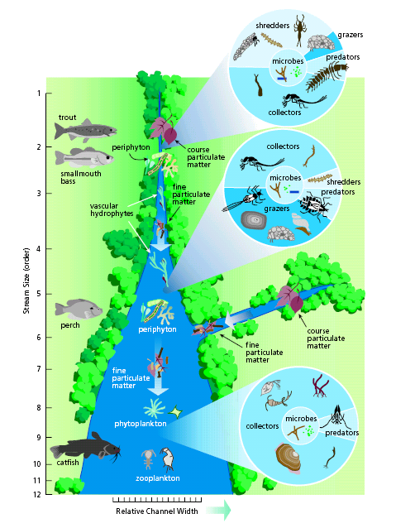
Rivers are Ecosystems
(Vannote, 1980; FISRWG, 1998)
Notes:
Rivers are ecosystems that support all levels of life.
Need good water quality to live.

Slide 11
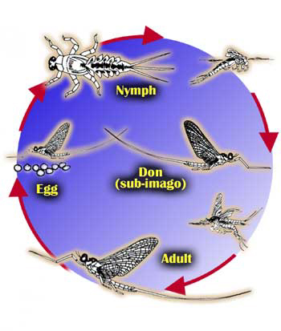
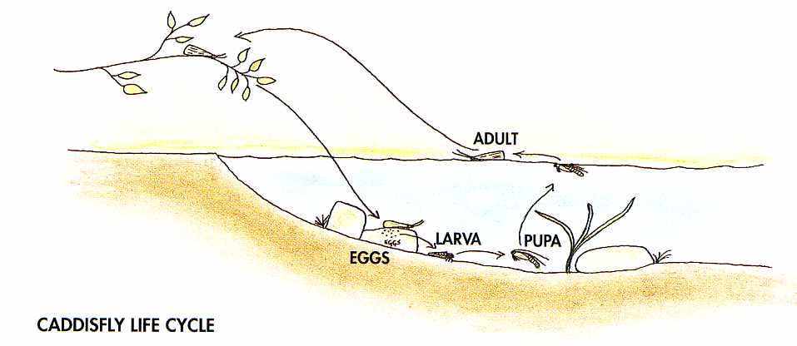
Rivers are Homes
(Kidfish CA, 2008)
(Bow River, 2008)
Notes:
All life stages from eggs to adults need to be able to survive.
We think about fish, but it is the insects and lower food chain that limit these populations.
Need healthy riparian vegetation, proper temps, proper substrate.

Slide 12
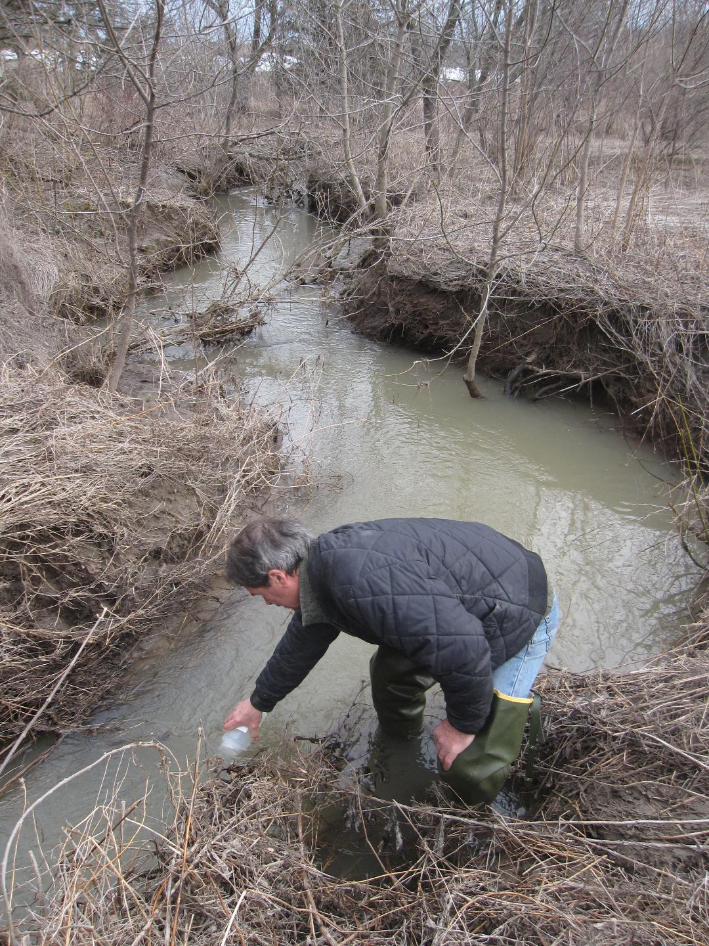
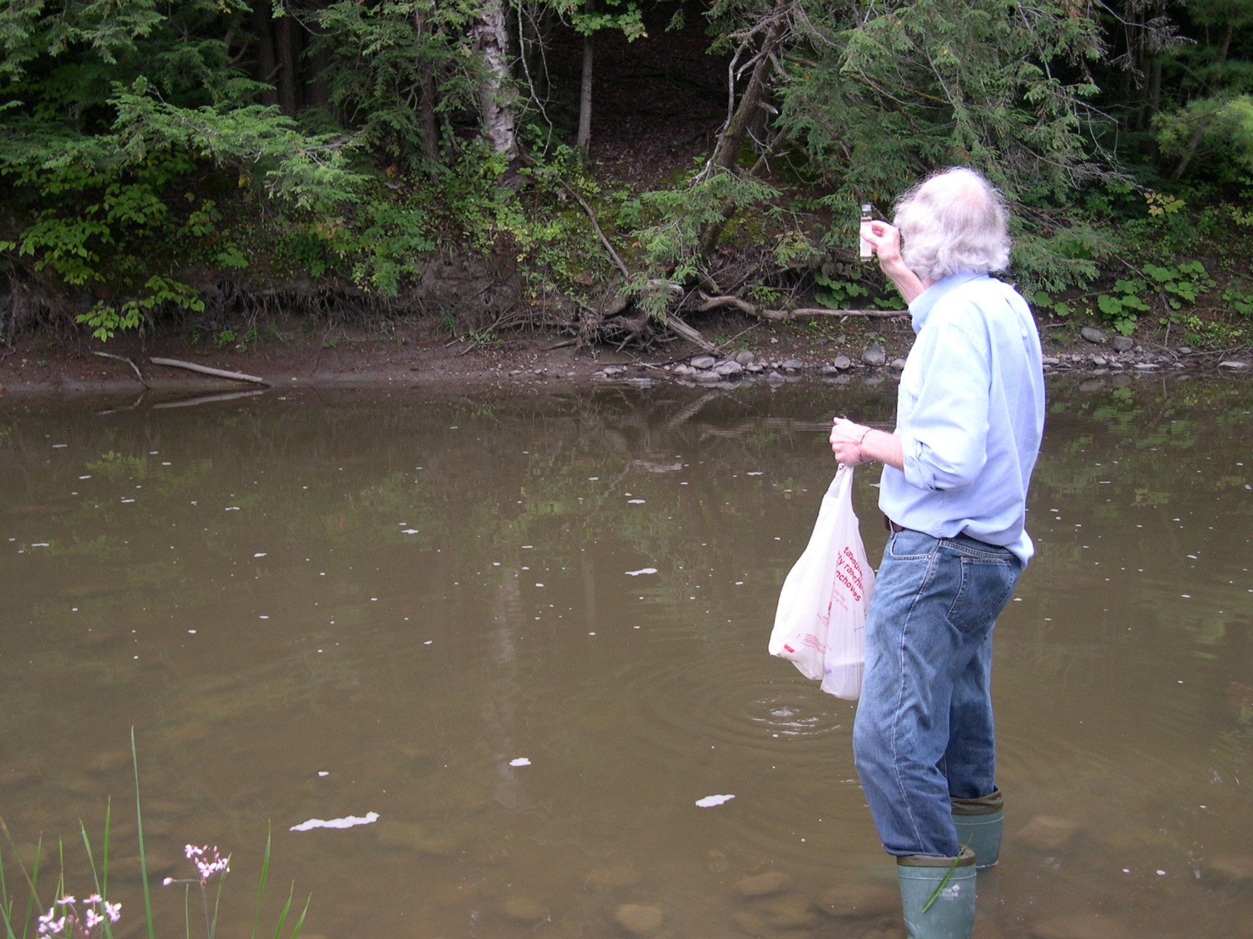
Water Quality Monitoring
12
Notes:
Does anyone know what is tested during water quality monitoring?
Volunteers complete it
Why would we want to have this data? – to understand the problems and guide how to fix them
Phosphorus, Chloride, E.Coli, Solids, Nitrogen

Slide 13
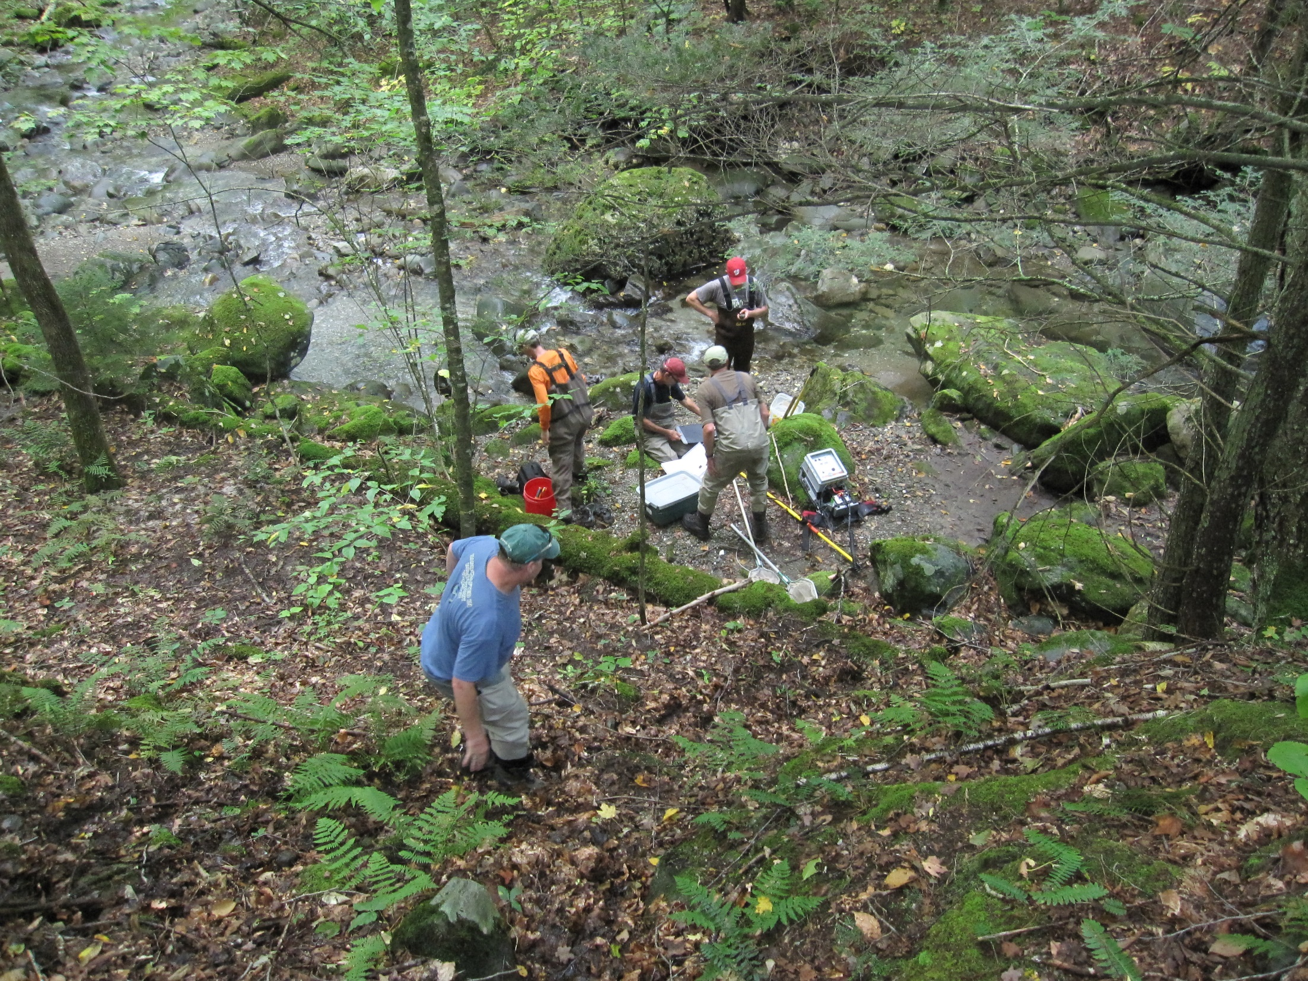
Water Quality Monitoring
Lewis Creek Headwaters
Bio-Monitoring
(LCA, 2013)
Notes:
Water Quality Measurements are done by volunteers to sample for specific nutrients and pollutants
The state also does bio-monitoring to evaluate fish and macroinvertebrate species present.

Slide 14
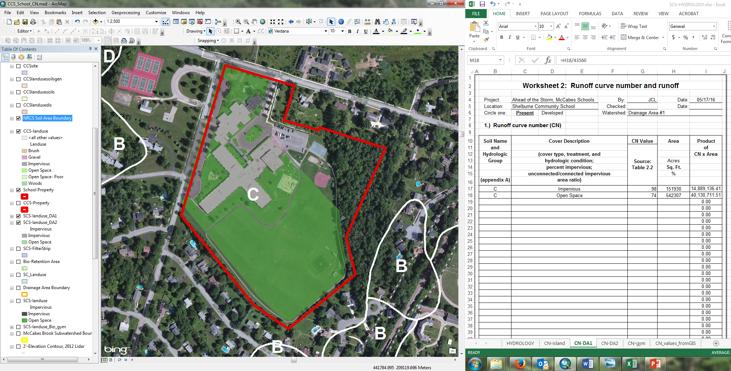
Hydrology - Calculate Runoff Volume
Landuse, Soil Type, Drainage Area, Flow Path Length, Precipitation
Notes:
There are a lot of different factors that go into calculating how much stormwater runoff there is
Including how much rain
We will get into this in detail later

Slide 15
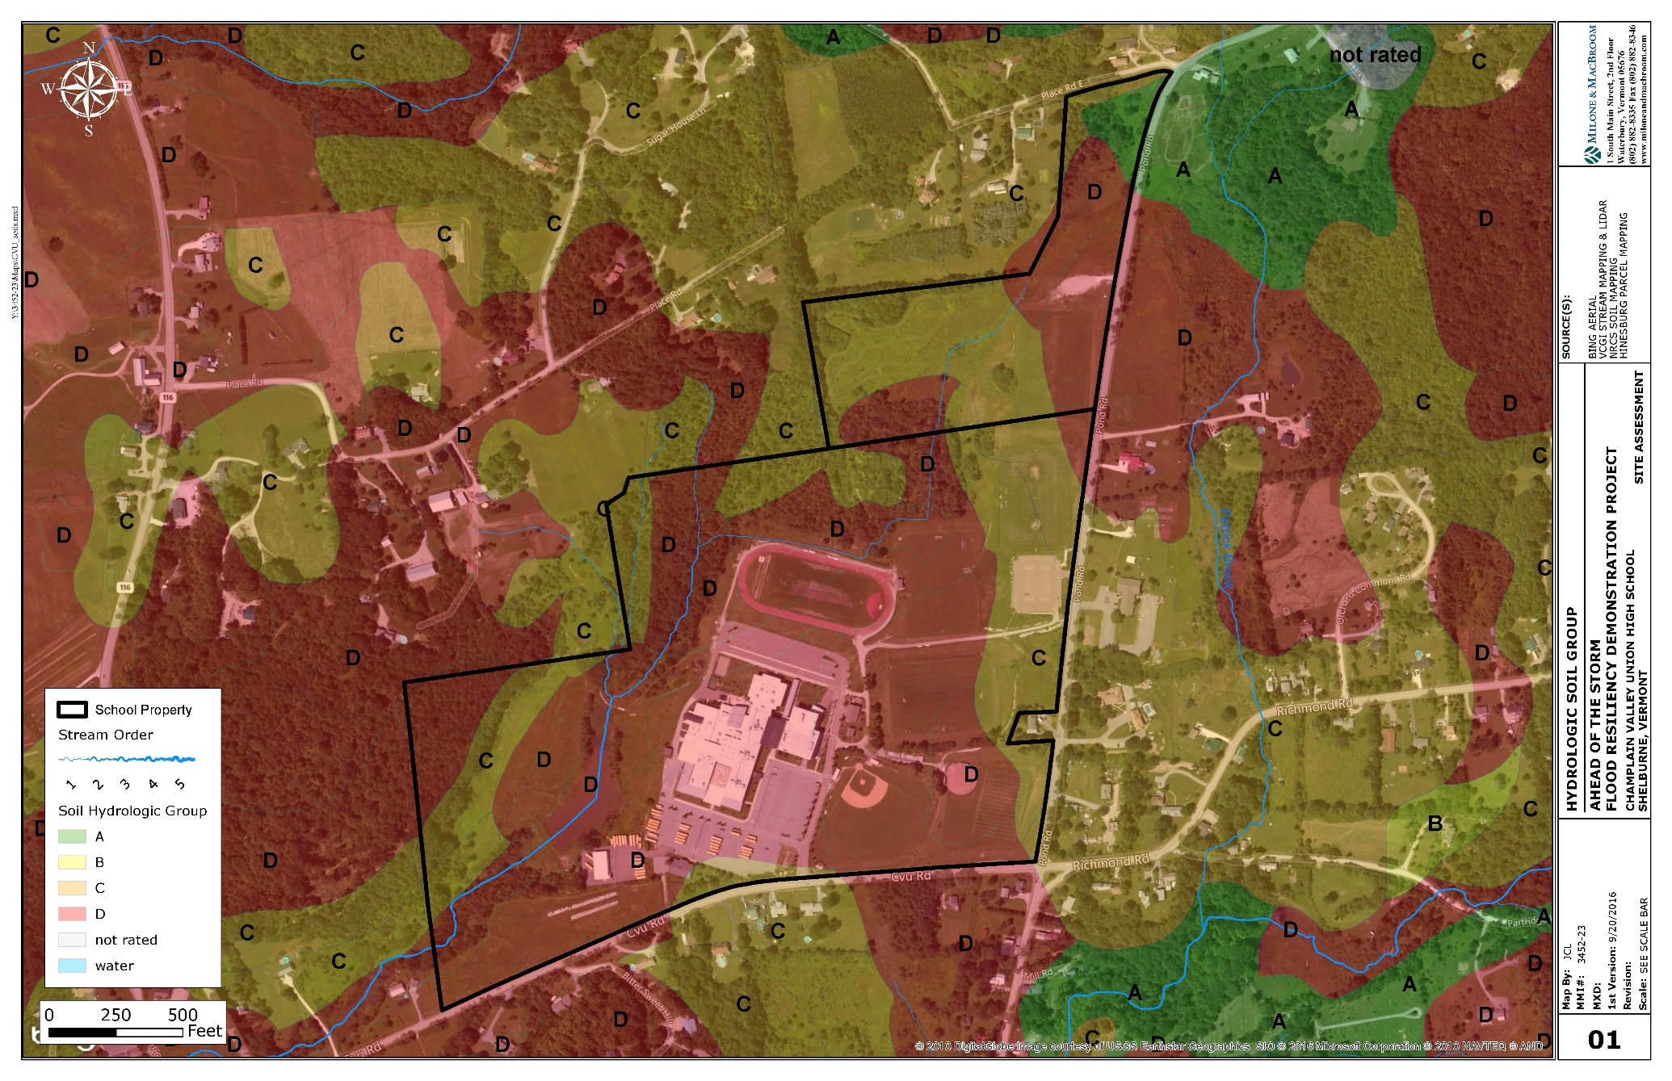
Hydrology - Soils
Notes:
Areas with different soils have naturally different infiltration rates.
Sandy- water sinks in like at the beach
Clay – water sits on the surface or runs off – wetlands are usually clay soils

Slide 16
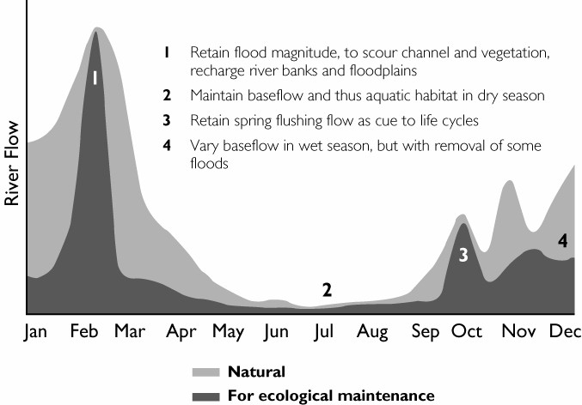
Hydrology
(Richter et al., 1997)
Notes:
Hydrologic range of variability.
Altered by watershed activities. Clearing, snow-making, urbanization, etc.

Slide 17
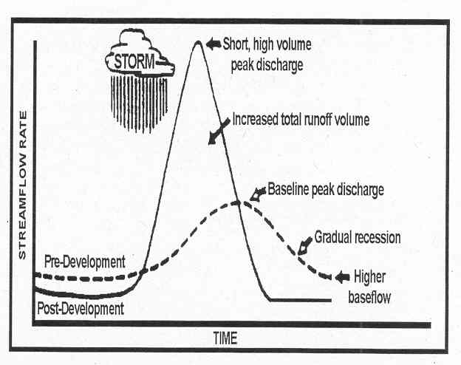
Unnatural Hydrology
Source: EPA, 1997
Notes:
Vertical – Stream Flow
Horizonatal – time
One storm
Peak is higher and earlier
More water getting to streams faster

Slide 18
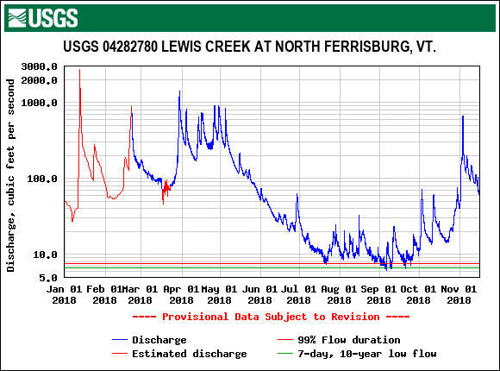
Measured Stream Flows
Notes:
USGS 04282780 LEWIS CREEK AT NORTH FERRISBURG, VT
Station operated in cooperation with the Lake Champlain Basin Program.
77 SM, 28 years,
Key data, Need more gauges

Slide 19
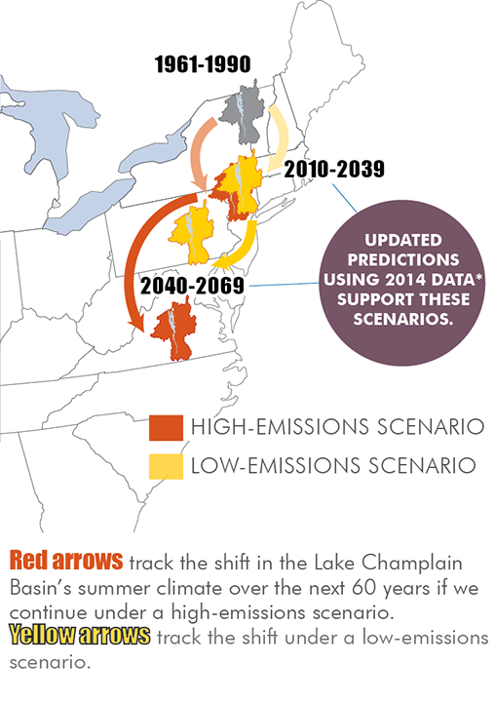
Extreme Storms and Climate Change
Source: LCBP, 2019
Notes:
HOTTER- National Academy of Sciences determined earths surface has risen 1 degree F in last century with acceleration in last two decades
Lake Champlain freezes over less frequently
Attributable to human activities

Slide 20
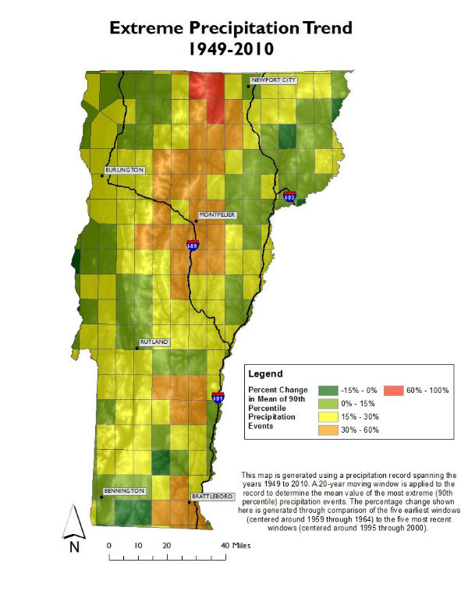
Extreme Storms and Climate Change
Source: Climatechange.Vermont.gov, 2019
Notes:
WETTER-
Larger storms
Extreme storms are more frequent storms – flooding happens more often
More extremes – including more drought

Slide 21
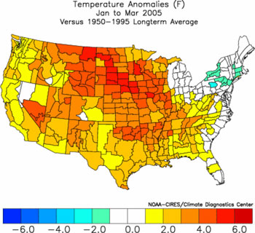
Weather versus Climate
Weather
  Day-to-Day
  Short term state of conditions
  Snapshot of what is going on now
  Temperature, Humidity, Precipitation, Cloud Cover, Visibility, Wind, Pressure
Climate
  Average of weather over 30 years or more
  Big trends
NOAA
Notes:
Climate is like the entire football season – preseason through superbowl
Weather is like one or two plays within a game
The planet is warming over a long time, but that doesn’t mean we will not have a cold day in winter.

Slide 22
The Valley and River Process
(Schumm1977; FISRWG, 1998)
Notes:
What is a river?
Potential to kinetic energy to move water, sediment and woody debris from upland to lowland.
Form and process.
Studies have shown that headwater conditions often dictate water quality, physical features, and biology downstream. Wood and sediment inputs are essential.

Slide 23



Urbanization of Rivers
Low-Energy Floodplains
(MacBroom, 1998)
Floodplain
Dam w/ Diversion
Filters Runoff & Sediment
Culverted Tributaries
Wildlife Corridor
Original Stream Channel
Diverse
Habitat
Source of Organic Material & Shade
Filled Wetland & Natural Floodplain
Progression of Urbanization
Fill
Small
Bridge
Piped Drainage
Lined
Channel
Direct Discharges
Retaining Wall
Channelized Stream
Realign Channel, Reduce
Habitat Size & Value
Concrete Liner
Culvert
Uniform Channel
Low Diversity
Culvert
Notes:
Urban rivers reduce the potential to have natural form and process and thus rivers are often managed.
You can see how this has happened over time in Hinesburg
Rivers are not typically straight, do not usually make right angle turns around field edges
The canal rerouted a channel
Development pushed streams aside

Slide 24
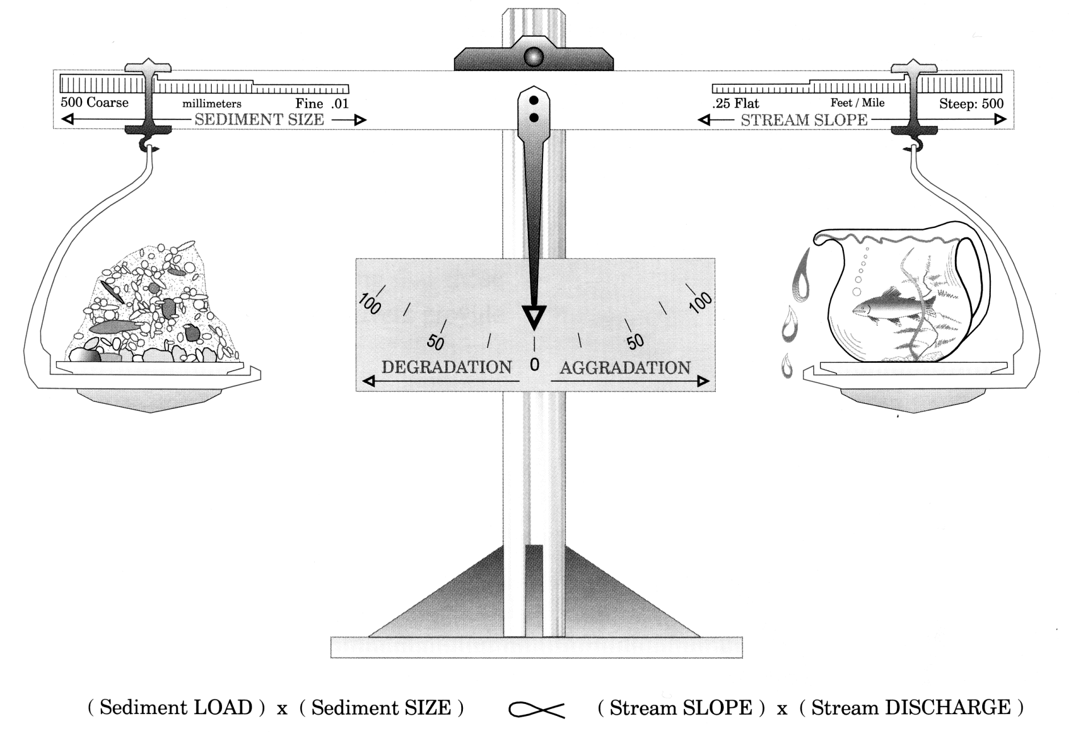
Unbalanced Rivers
Source: Lane, 1955; Rosgen and Silvey, 1996
Notes:
When we add more water the balance is off
It increases the water power and leads to erosion

Slide 25
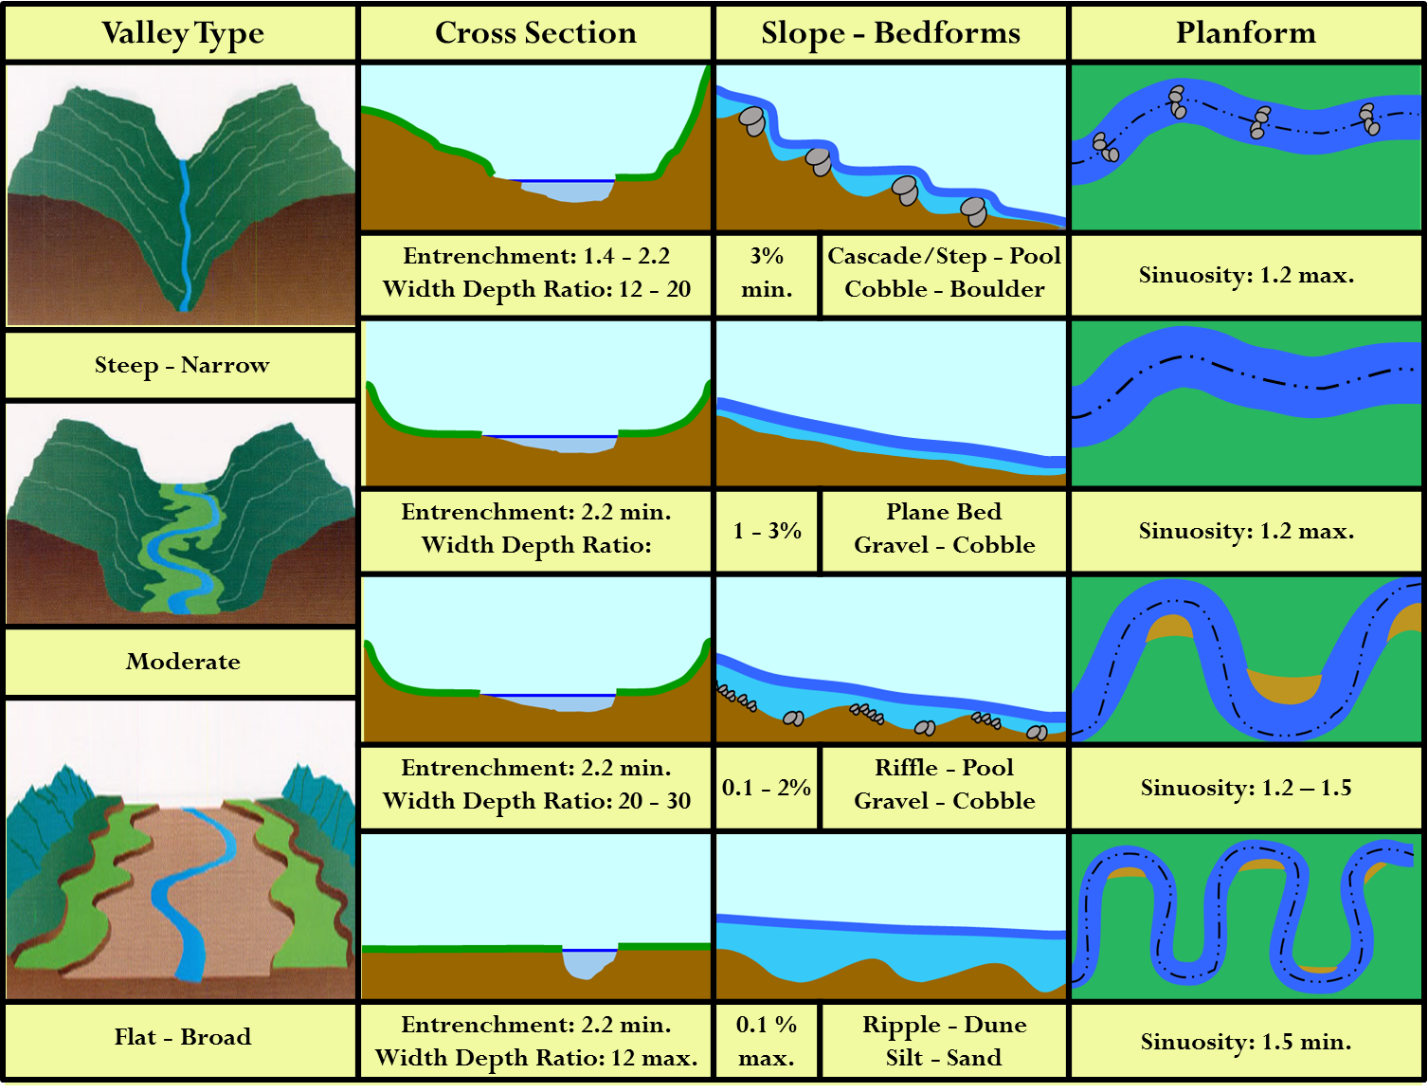
Fluvial Geomorphology
(ANR, 2017)
Notes:
A river’s form and process – what it looks like and how it acts
Morphology is determined by valley setting.
When we add extra water from runoff or climate change, it changes how rivers act and move
This can cause erosion or flooding
It can damage property as it trys to regain its balance again

Slide 26
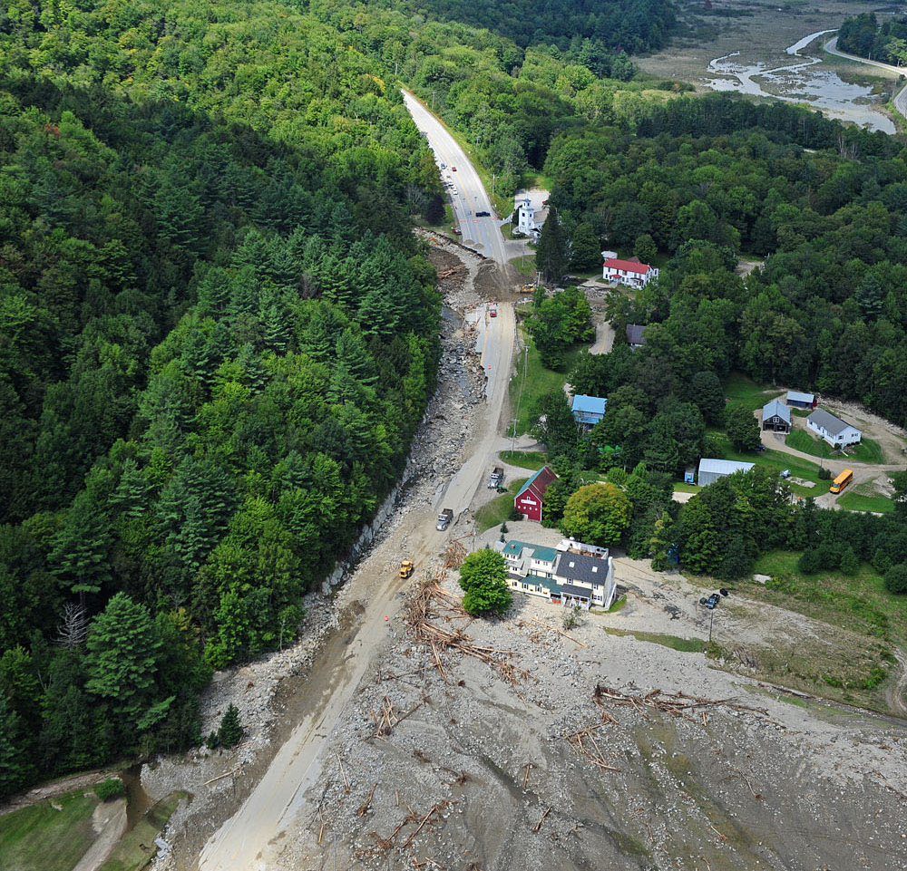
Flood Resiliency
Roaring Brook
US Route 4 in Killington, VT
Photo by Lars Gange & Mansfield Heliflight, August 31, 2011)
Notes:
You can imagine the water from a river flooding a home or downtown, but what people don’t always think about is the rocks, trees, and other debris that the water carries with it.
Rivers can be so powerful that they wash out roads
And carry tons and tons of sediment that can clog bridges and culverts and bury homes.

Slide 27
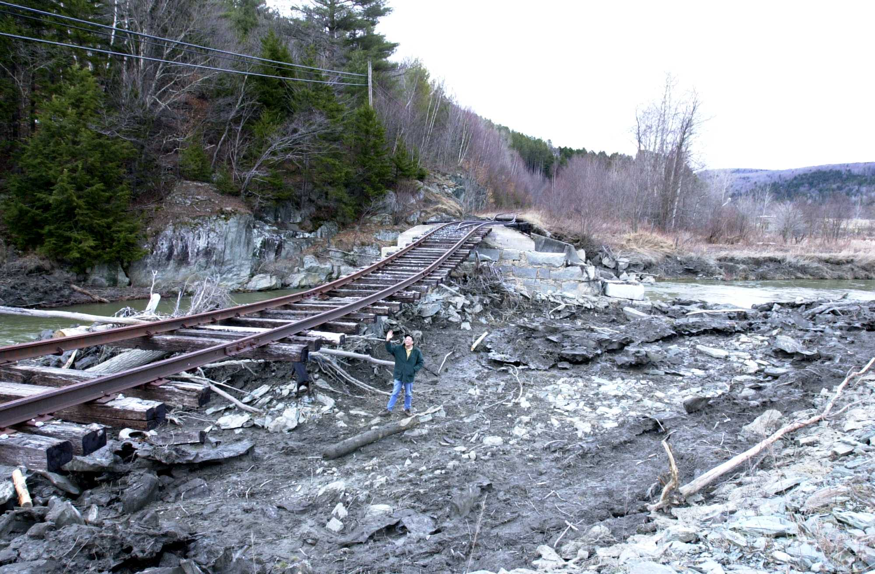
Flood Resiliency
Bridge washout over Wild Branch in Wolcott, VT
Photo by M. Heaton
2000
The goal of the Ahead of the Storm program is to implement water quality conservation practices that are more flood resilient throughout the LaPlatte and adjoining watersheds.
Notes:
River erosion and flooding are hazards.
Does anyone know anyone who’s home flooded? Road flooded? A spot with erosion?
We need to prepare for extreme weather and climate change.
Resilient designs will help.

Slide 28
Ahead of the Storm - Optimal Conservation Practices
The 3 S’s….
SLOW IT DOWN
SPREAD IT OUT
SOAK IT IN
Notes:
To be more flood resilient we can take steps to reduce the amount of runoff and therefore the amount of water in our rivers.
Our goal is to identify locations where water is collected and concentrated or where dirty water is running off impervious surface.
Once identified we will want to consider ways to Slow, Spread, and Soak.
Next time we get together we will learn more about how that can be done.

Slide 29
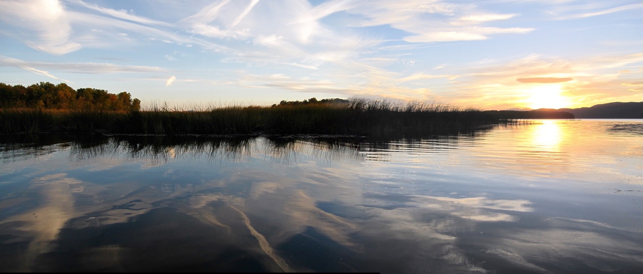
Watershed Jeopardy
Lewis Creek at Lake Champlain
Ferrisburgh, VT
Terry Dinnan, 2010
Notes:
Describe Watershed Jeopardy
Describe “rain” activity - straws, aluminium foil, moss, cardboard, etc and had the students build a replica of their school, then I came around with a squirt bottle and "made it rain" and we watched and discussed where the water went. We ended with a discussion on what could be done on the school campus to slow, soak, spread water.
or a discussion with teachers about how they think some of this material could be taught at their age groups.

