Slide 1




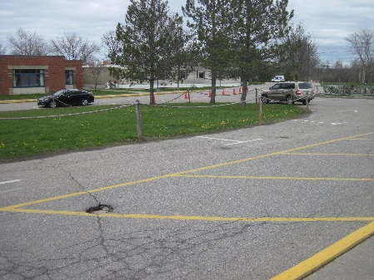
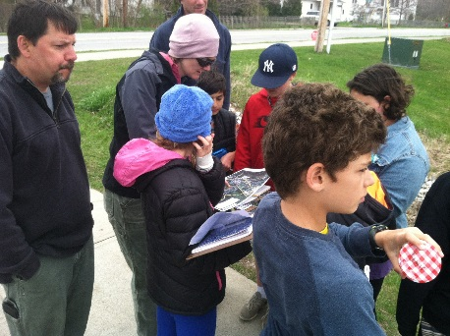
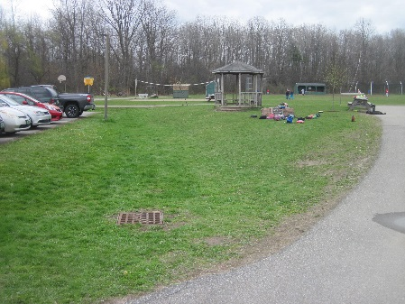
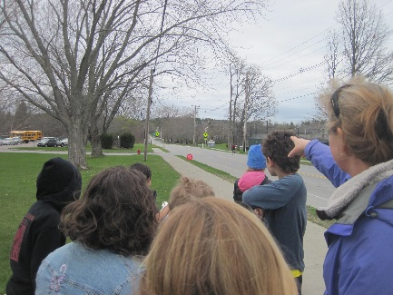
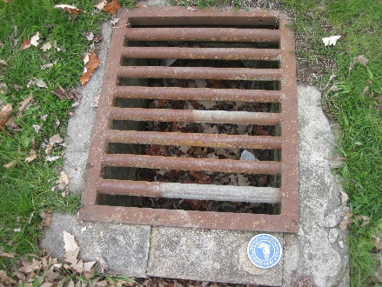
Ahead of the Storm
Education and Outreach
AOTS Program Background
Presented By: Jessica Louisos, MS, PE
Funded by the Lake Champlain Basin Program - L-2019-032 EO AOTS Project

Slide 2



Overview
Learn about:
  What is Ahead of the Storm?
  Water Quality Sampling
  Scorecard map
  Optimal Conservation Practices
Complete:
  Visit LCA website to view resources

Slide 3


Ahead of the Storm
Water Quality stewardship program
Improving flood resiliency and water quality
Prevent and reduce speed, volume, and pollution associated with stormwater runoff
Incorporate effects of climate change – look to future
Watershed wide:
  LaPlatte River
  Thorp Brook
  Kimball Brook
Multi-Town:
  Hinesburg
  Charlotte
  Shelburne
Notes:
2014 members of the Charlotte Congregational Church and LCA joined to discuss serious decline of Lake Champlain’s health and water quality
Committed to helping communities change the way stormwater is managed
Reduce water pollution
Be more prepared for extreme weather events

Slide 4
Ahead of the Storm Partners
Lewis Creek Association
Milone & MacBroom
Charlotte Congregational Church
Town of Shelburne
Town of Hinesburg
Town of Charlotte
South Chittenden River Watch
LaPlatte Watershed Partnership
Place Creative Company
AOTS Demonstration Site Property Owners
Kelsey Trust, Vermont Community Foundation
Vermont Agency of Natural Resources
Winooski Natural Resources Conservation District
Lake Champlain Basin Program
VTrans Better Roads Program
UVM Lake Champlain Sea Grant
The Nature Conservancy, Vermont Chapter
CVSD School District
Notes:
Many Many Partners
Without participating landowners there is no project

Slide 5
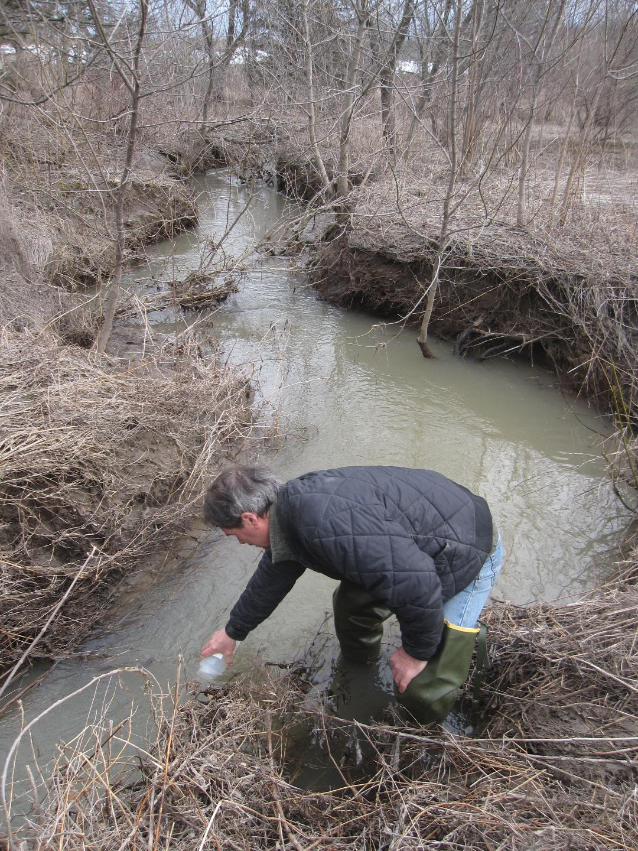
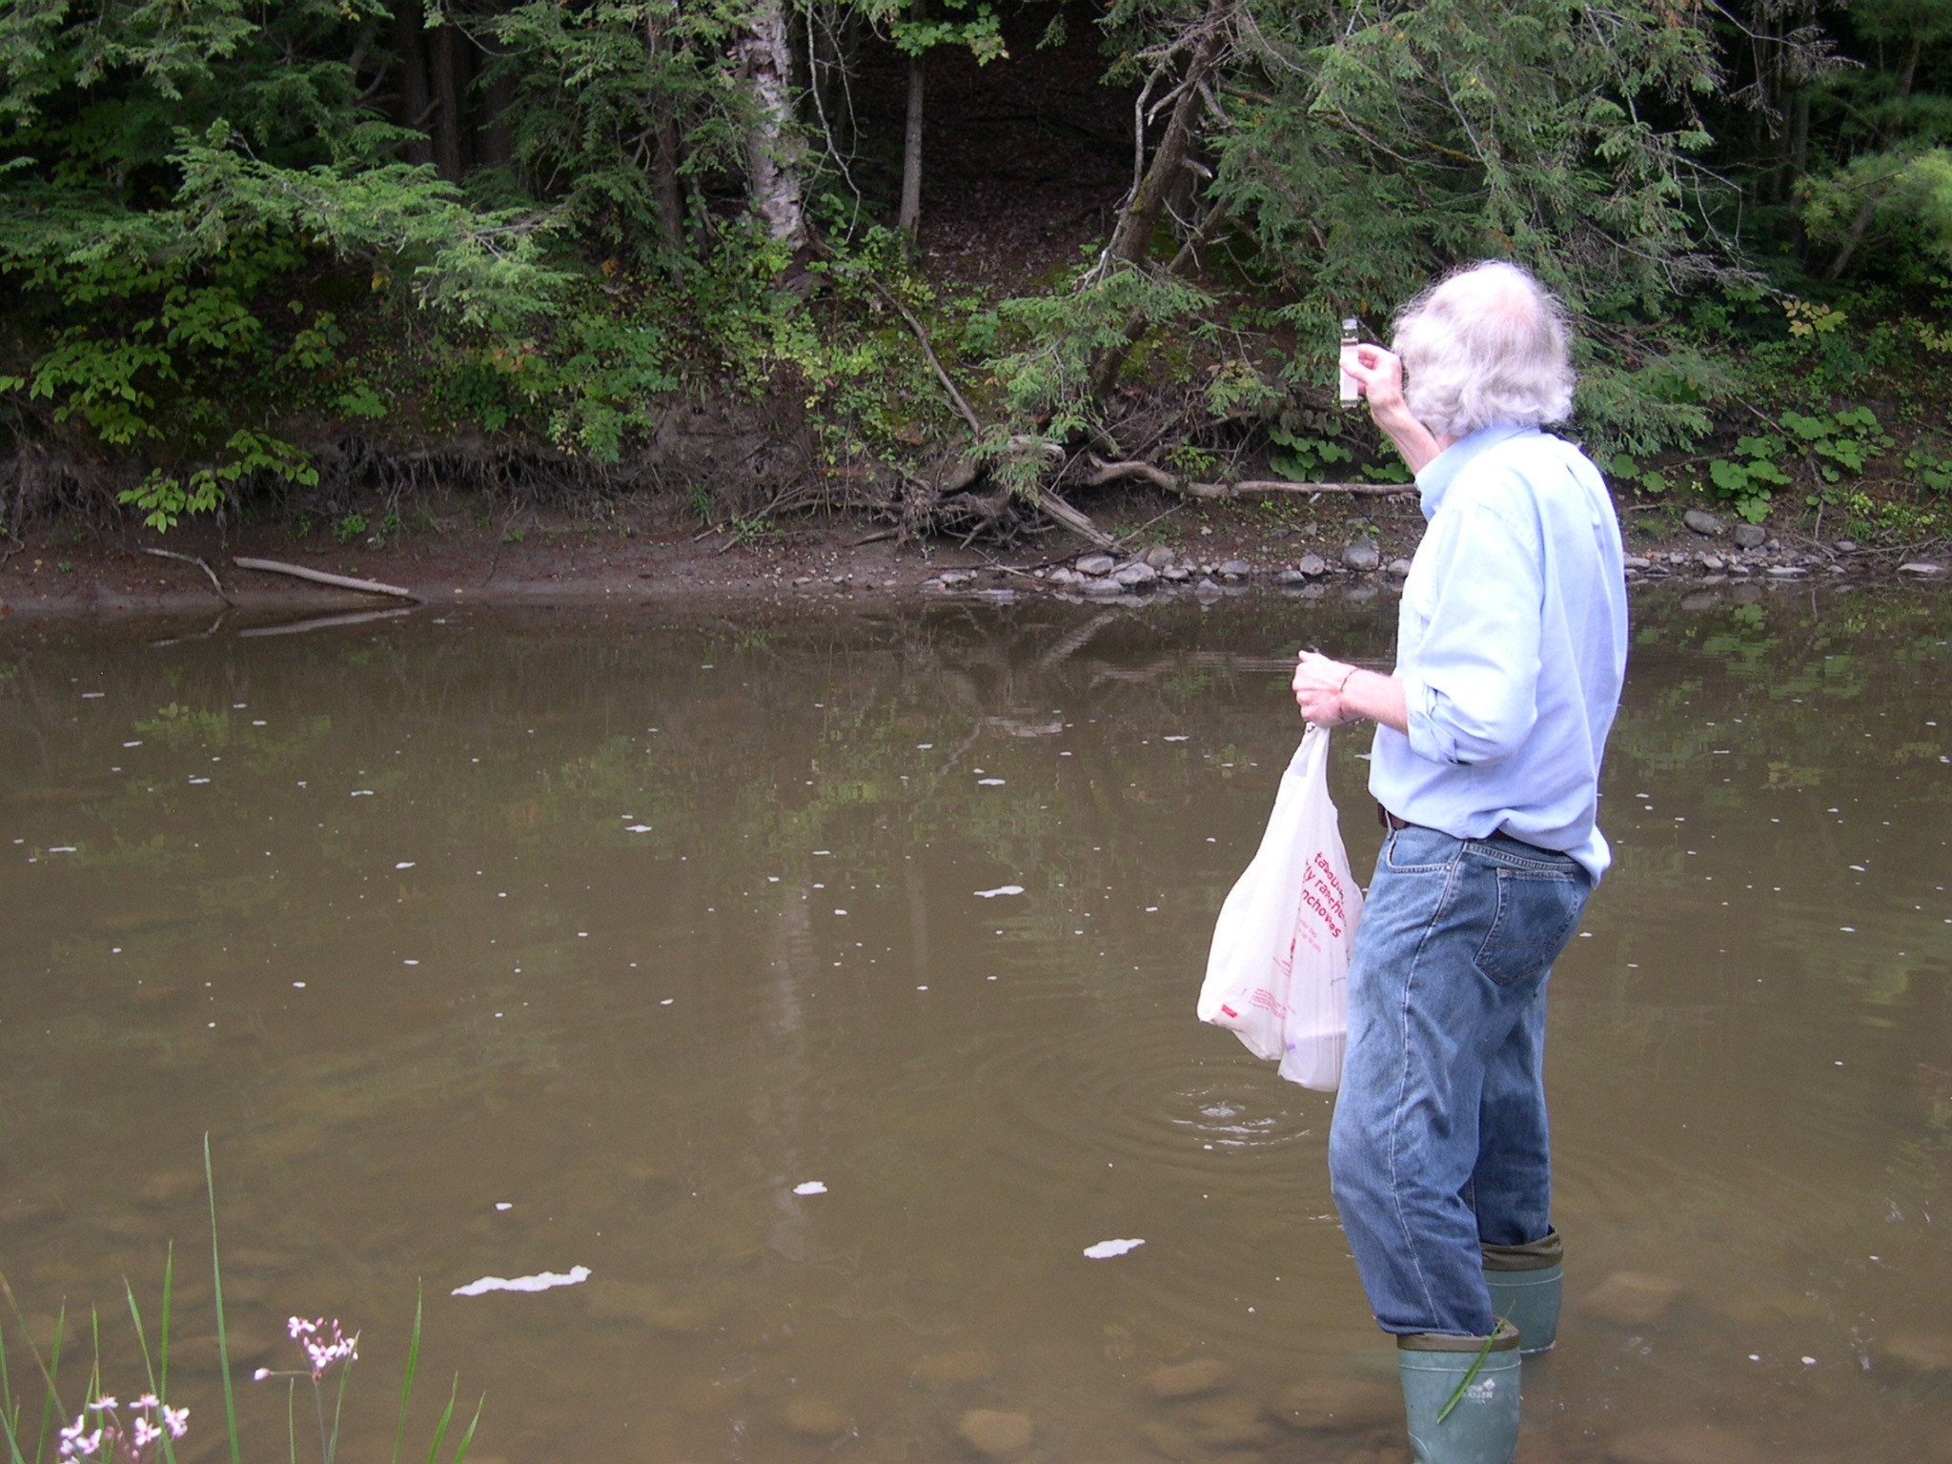
Water Quality Monitoring
5
Notes:
Does anyone know what is tested during water quality monitoring?
Volunteers complete it
Why would we want to have this data? – to understand the problems and guide how to fix them
Phosphorus, Chloride, E.Coli, Solids, Nitrogen

Slide 6
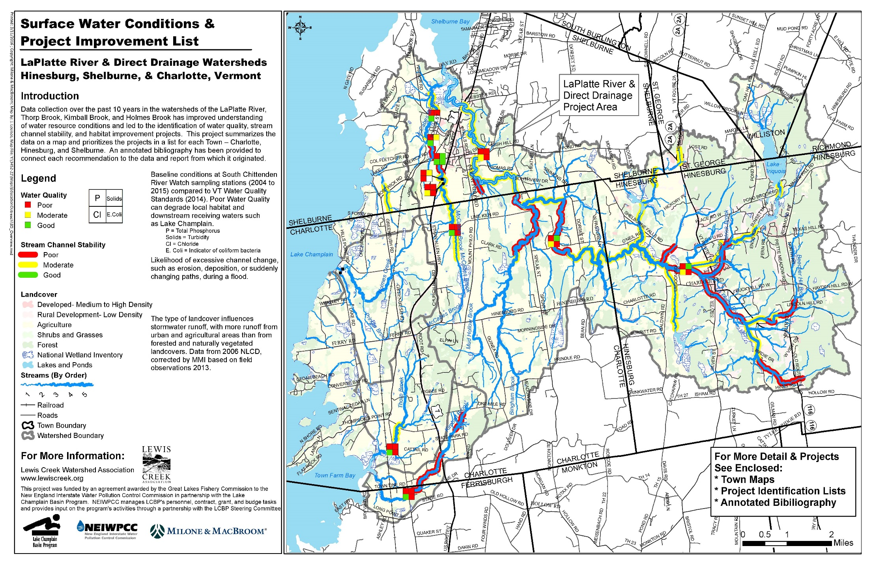
Ahead of the Storm – Water Quality
6
Notes:
Describe water quality sampling locations.
With students this would be good to have as a handout blown up big so they can find areas themselves
Where is your school
What do the 4 squares mean? – volunteers do the water quality monitoring and this is a summary of the results
Where is there the highest Phosphorus = in LaPlatte River and direct lake watersheds

Slide 7

Optimal Conservation Practice
7
Notes:
This list is included in the AOTS intro packet – a great resource – along with examples, references, glossary
Bring up Intro Packet to show what the document is.

Slide 8
Ahead of the Storm
15 locations designed
Optimal Conservation Practices
www.lewiscreek.org
Notes:
Go to webpage and look at an example location with documentation
Have SCS or other packet on hand in case web link doesn’t work.

Slide 9
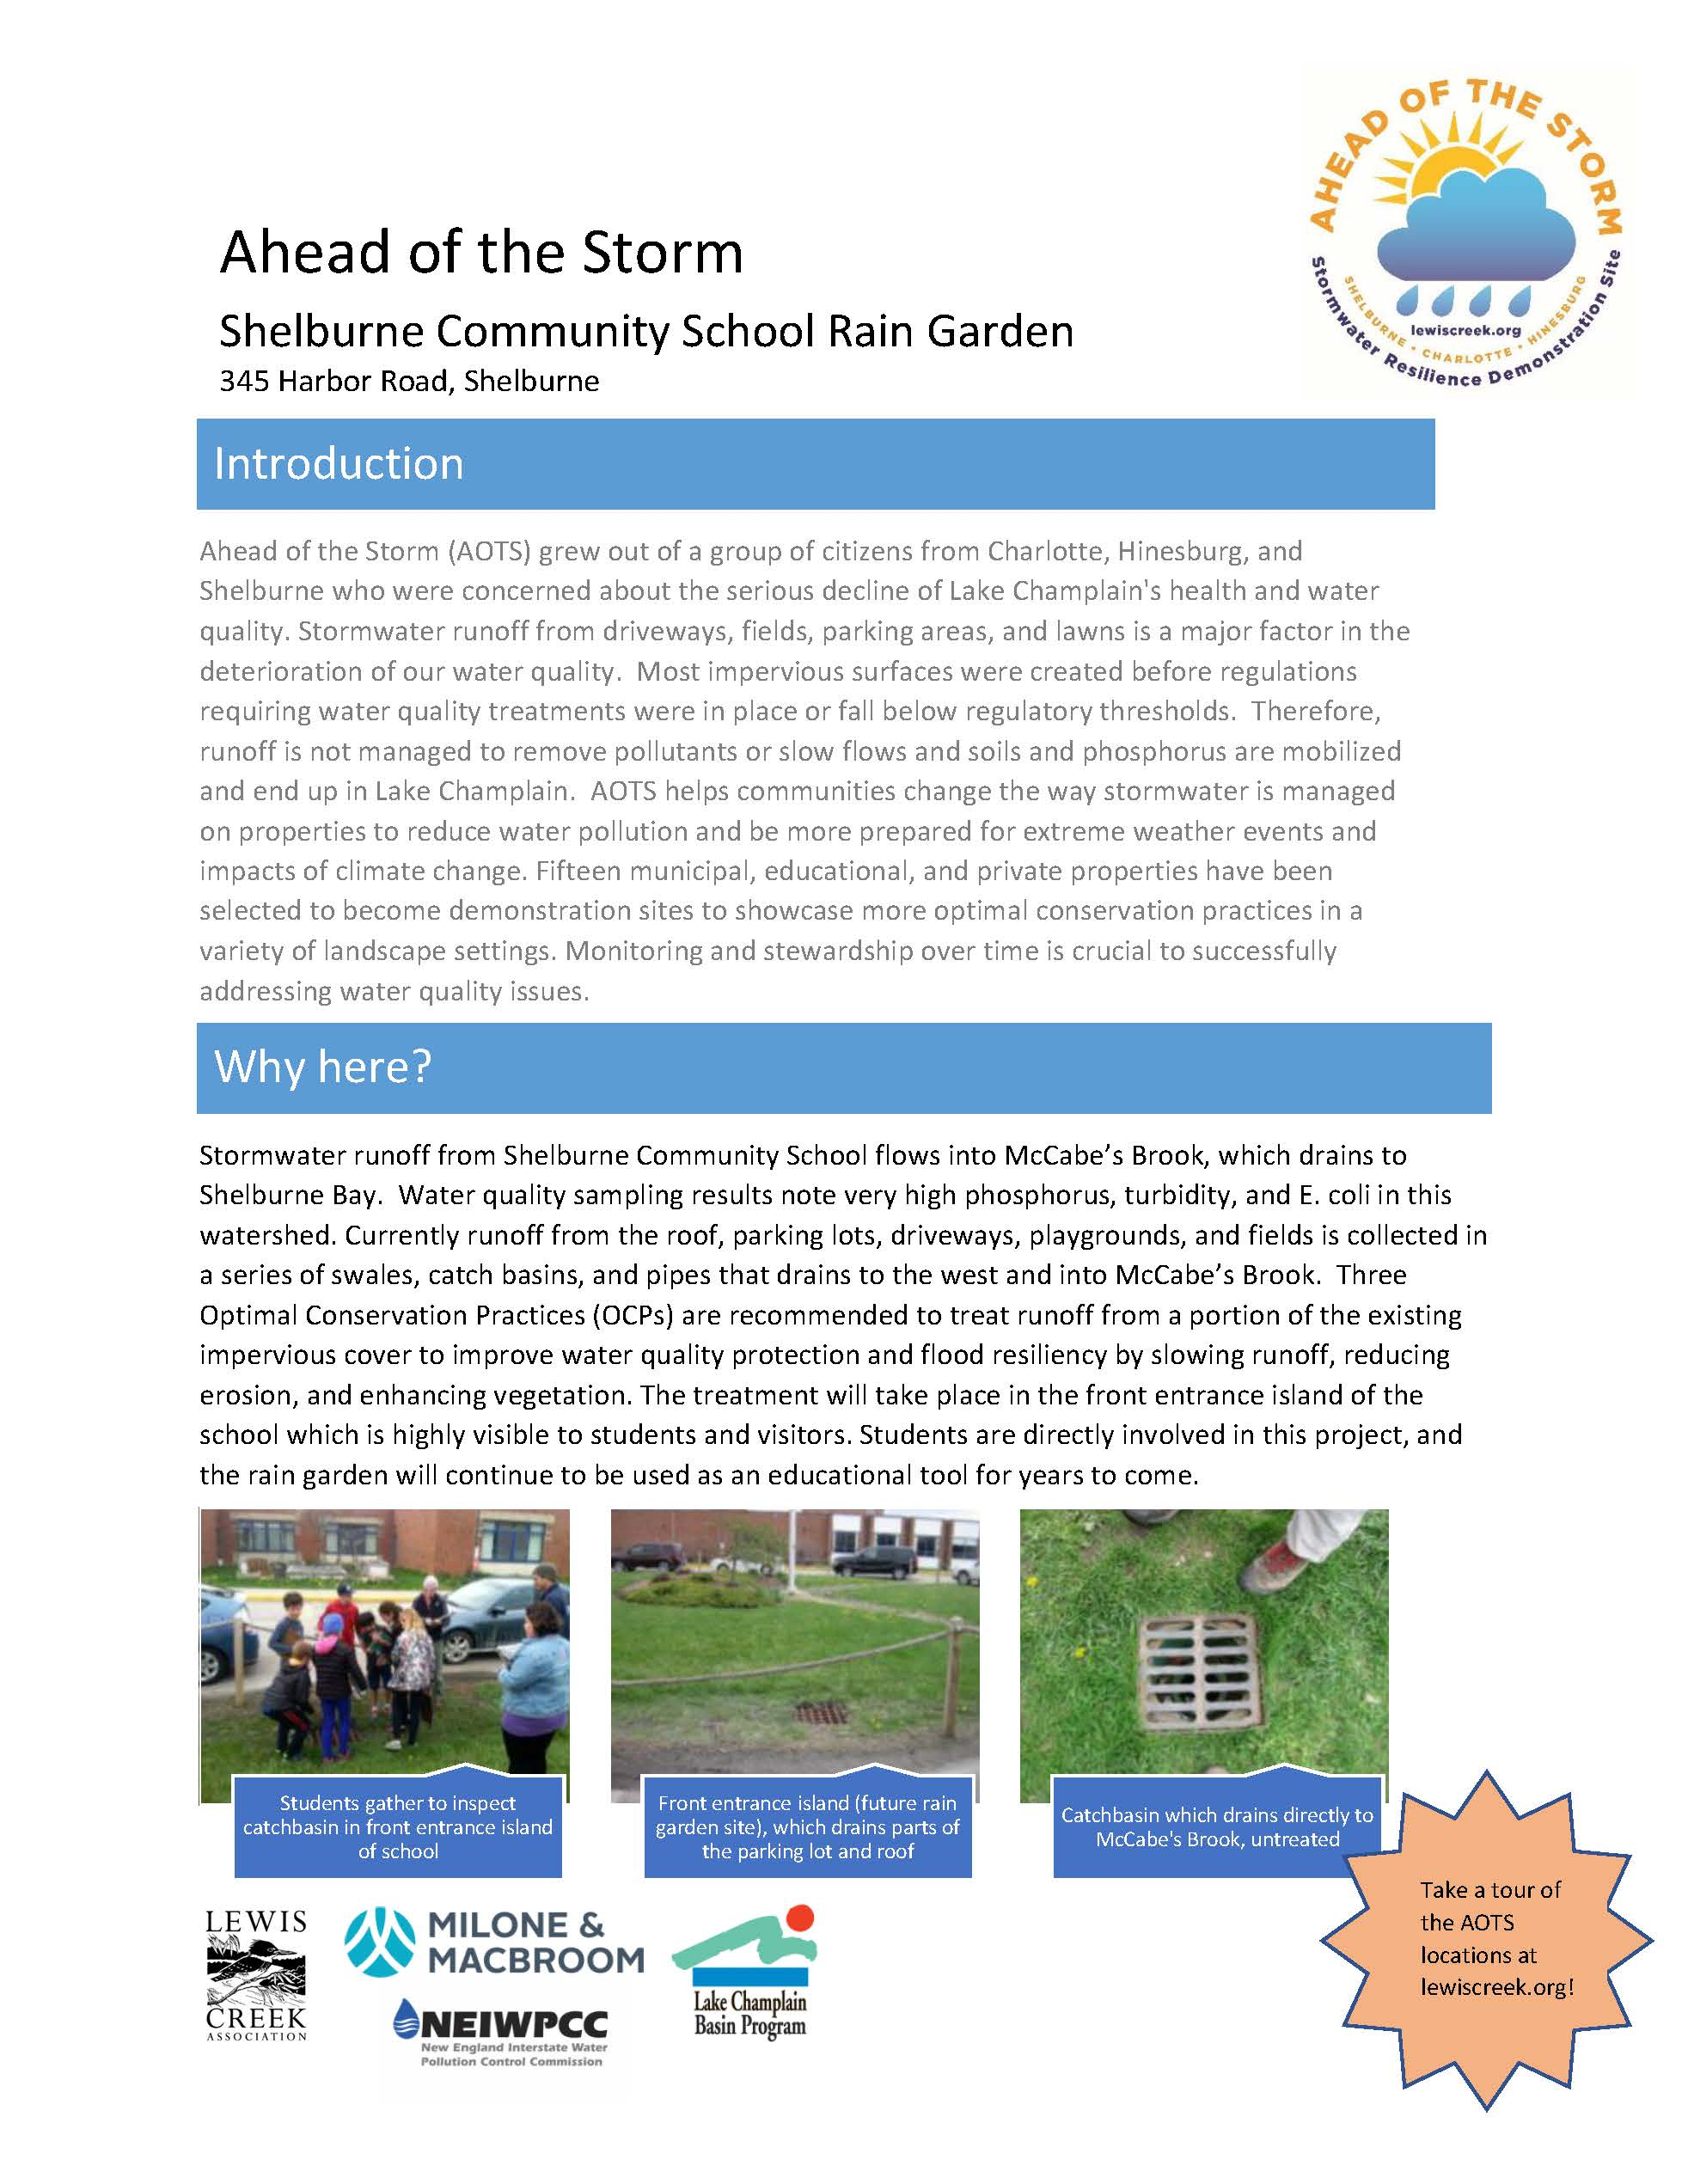
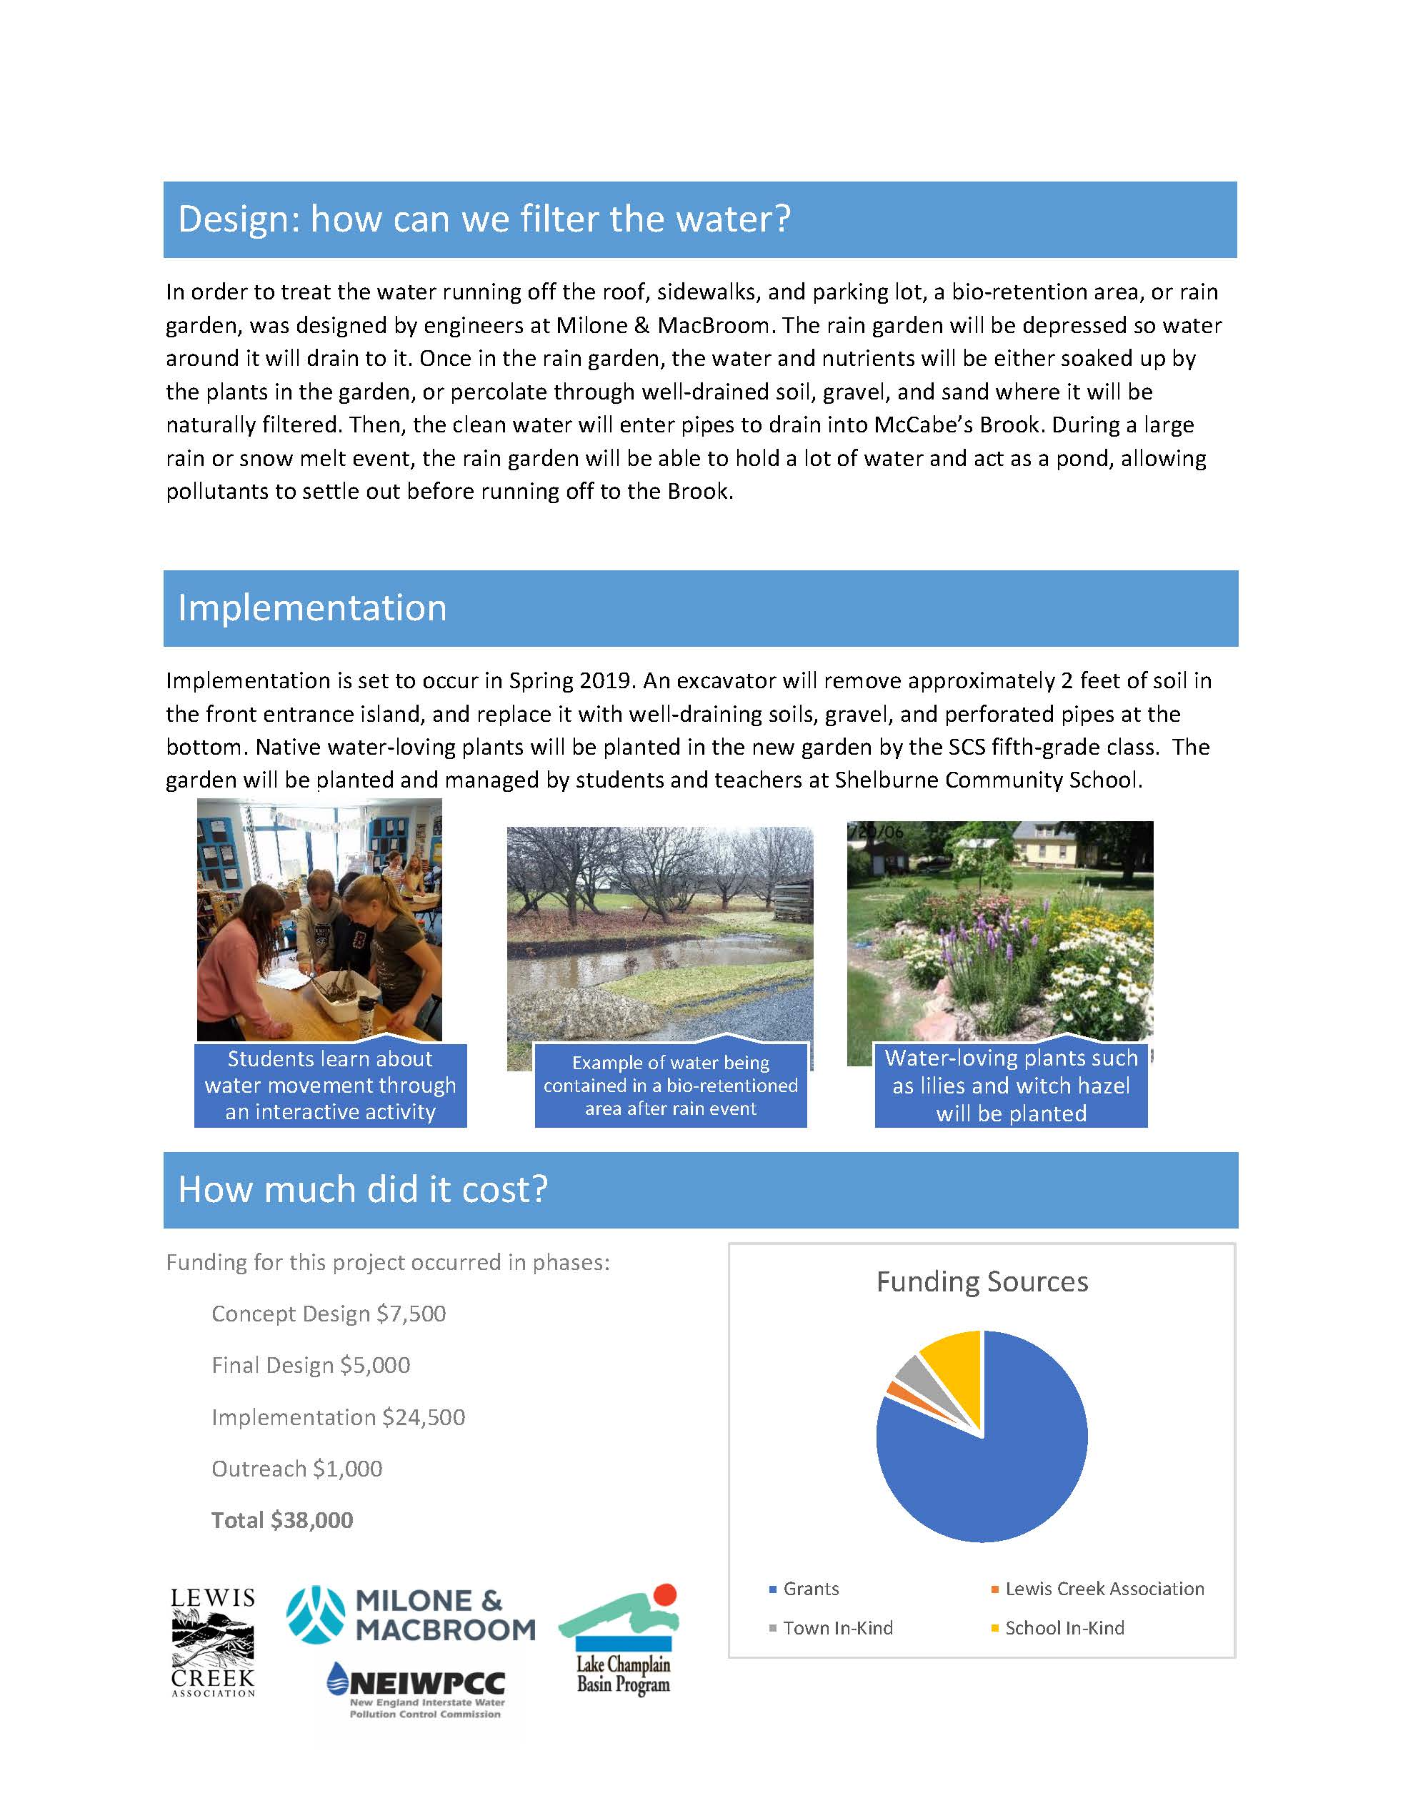
AOTS OUTREACH MATERIALS
9
Notes:
Summaries of each site area available at the Charlotte Library and on the LCA website
Giver overview of the project, the need, the design, and costs

